Slide 2
File Handling
Introduction
Data files
Opening and closing files
Working with text files
Standard Input,Output and Error Streams
Working with Binary Files
Working with CSV Files

Slide 3
File Handling
What is file??
A file in itself is a bunch of bytes stored on some storage device like hard disk.
It help in storing information permanently.
Every programming language offers some provision to use and create files through programs.
There are two types of files:
They are
Text files
Binary files

Slide 4
Contd...
What is text file?
There is normal text file for eg:notepad file
There is no convertion (human to machine language)
Data which store directly.
Basically when we open the file it will be in readable form
It is slow while comparing to binary file.
What is binary file?
A binary file stores the information in the form of bytes.A binary file contains information in the same format in which the information is held in the memory.
Binary files are faster because it is not in human readable form and easier for a program to read and write than are text files.
It is used to store audio,video and images.

Slide 5
f=open(“text.txt”,”r”)
f -> file object or file handle
f=open(“C:\myfolder\text.txt “,”r”)(wrong)
Because in this \text.txt (\t,\n,\r python will consider this as special characters)
f=open(“C:\\myfolder\\text.txt”,”r”)(correct) or
f =open(r”C:\myfolder\text.txt”,”r”)(r denotes a raw data)

Slide 6
Access Modes
r r+
w w+
a a+
Text files
rb rb+
wb wb+
ab ab+
Binary files

Slide 7
Contd….
f=open(“ss.txt”,”r”)
Print(“file name”,f.name)
Print(“file mode”,f.mode)
Print(“Isfilereadable:”,f.readable())
Print(“Isfile closed”,f.closed)
Output:
ss.Txt
r
True
False

Slide 8
Contd…
f=open(“ss.txt”,”r”)
str=f.read()
Print(str)
(Or)
f=open(“ss.txt”,”r”) print(f.read())
f=open(“ss.txt”,”r”) print(f.read())
f.read(3)
ss.txt
A B C D
E F G H
A B C D
E F G H
A B C D
E F G H

Slide 9
Contd…
A B
f=open(“ss.txt”,”r”)
f.read(3) print(f.read(3))
f=open(“ss.txt”,”r”)
s=f.readline()
Print(s)
s=f.readline()
Print(s)
f=open(“ss.txt”,”r”)
s=f.readline()
Print(s,end=“ “)
s=f.readline()
Print(s)
A B C D
E F G
A B C D
E F G

Slide 10
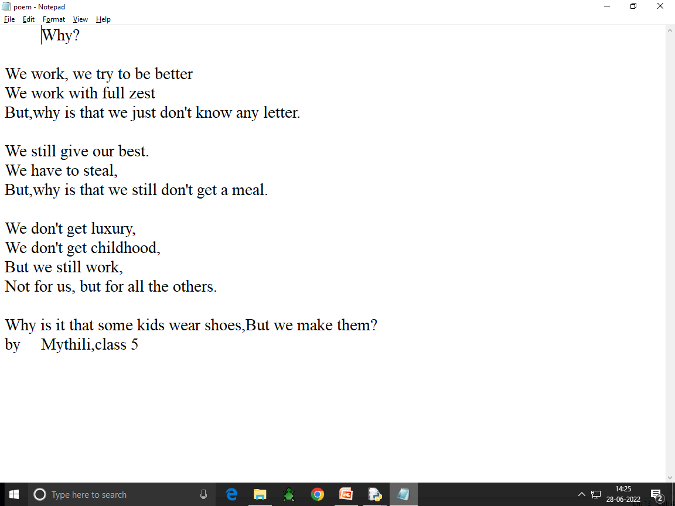

Slide 11
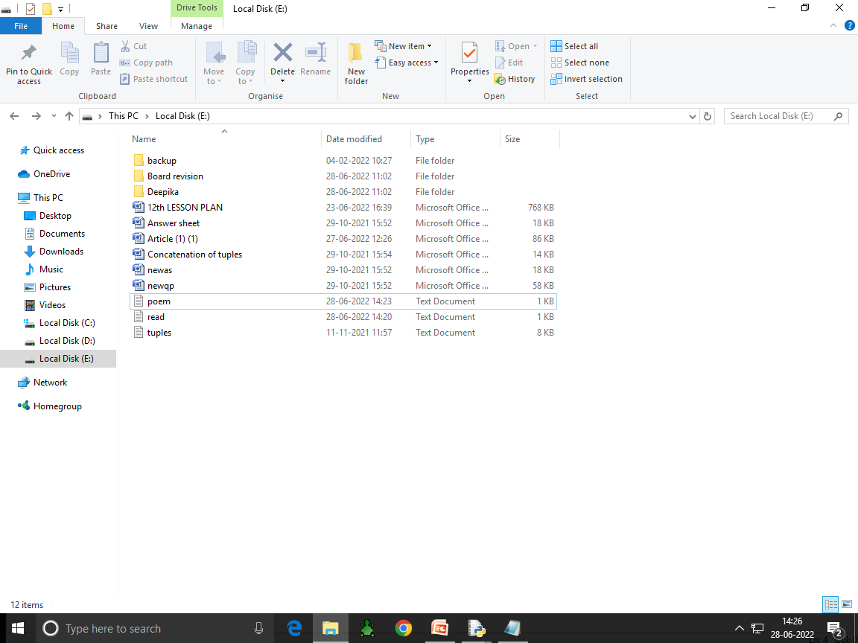

Slide 12
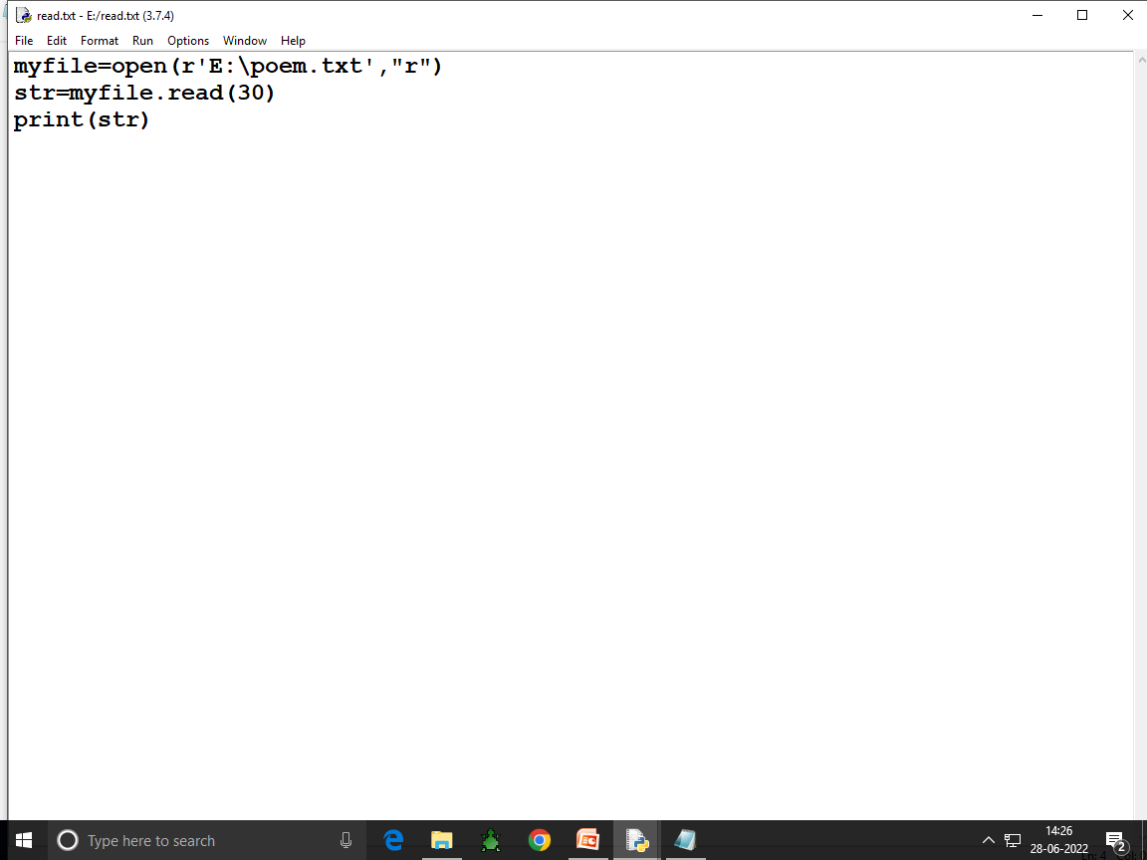

Slide 13
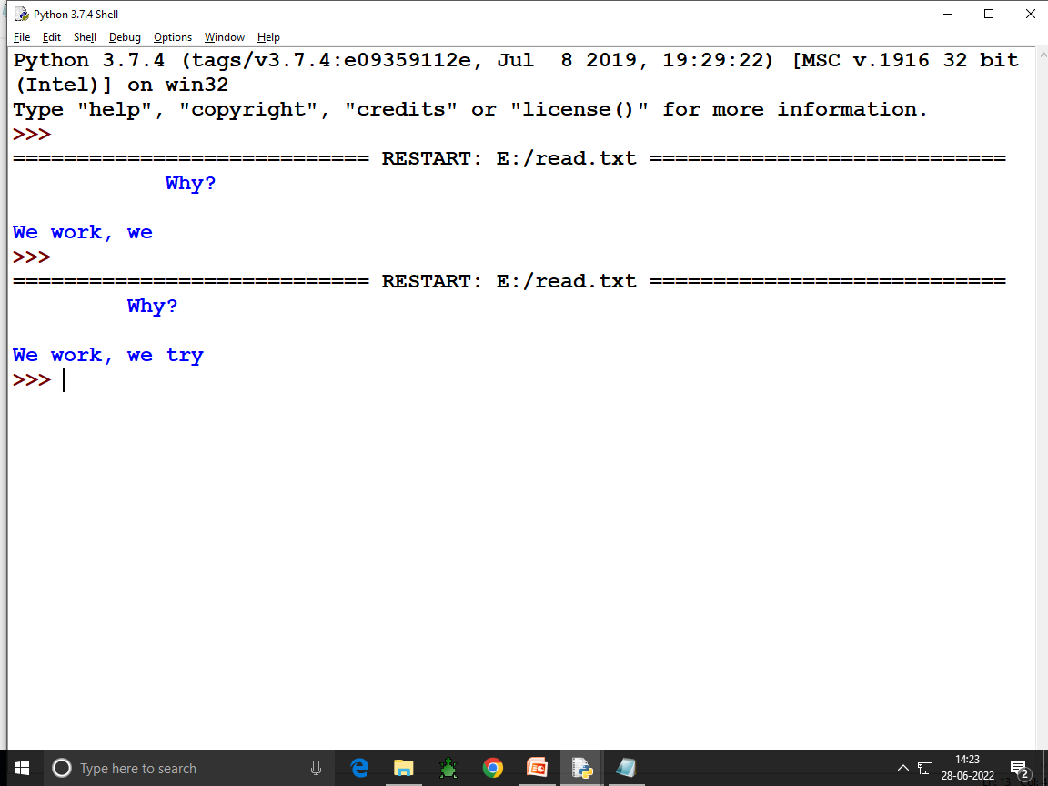

Slide 14
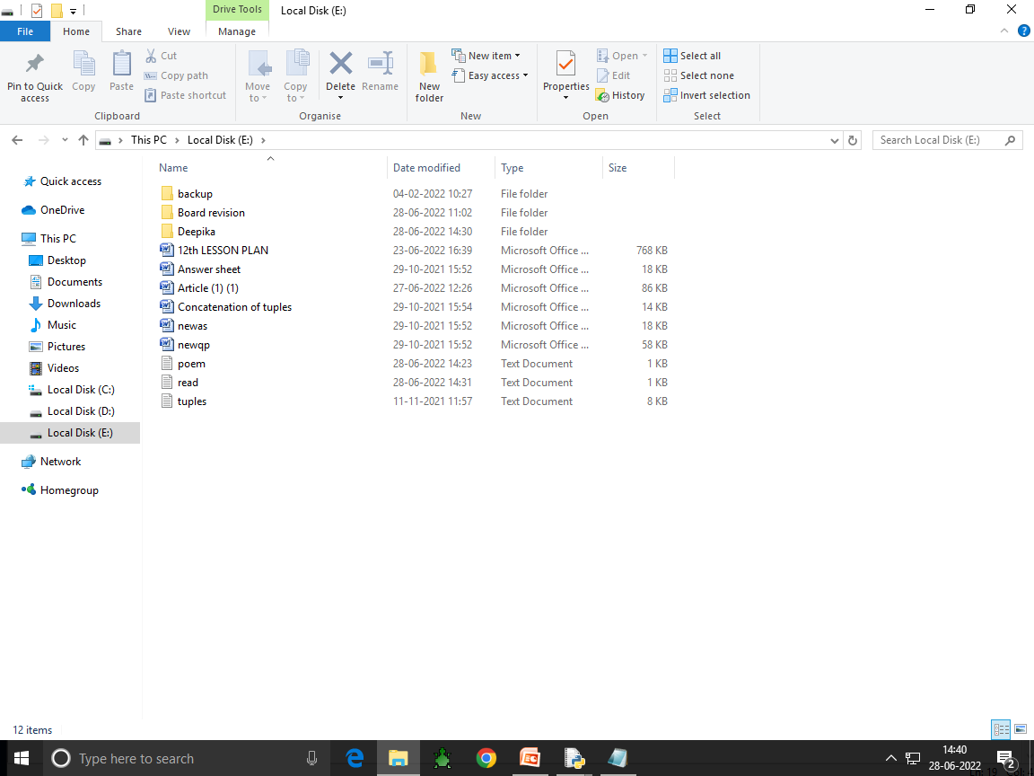

Slide 15
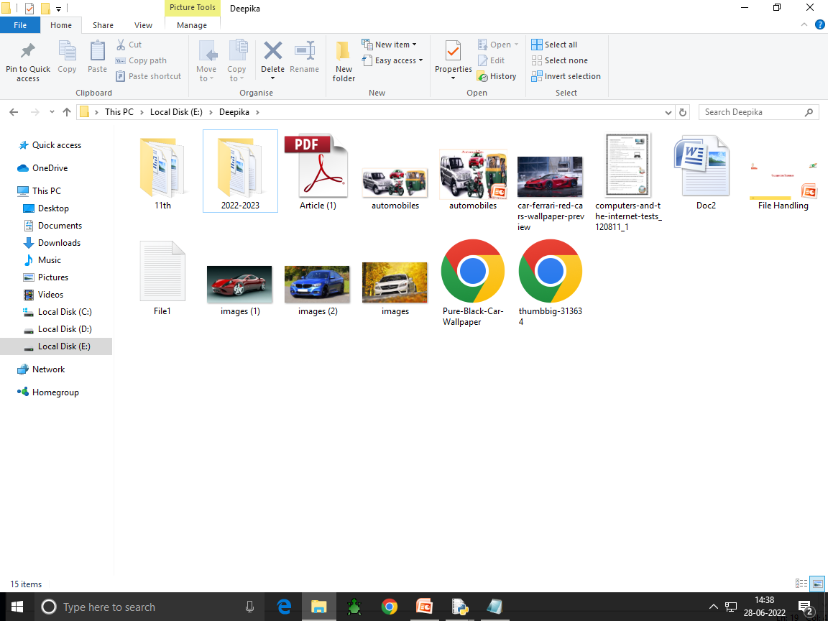

Slide 16
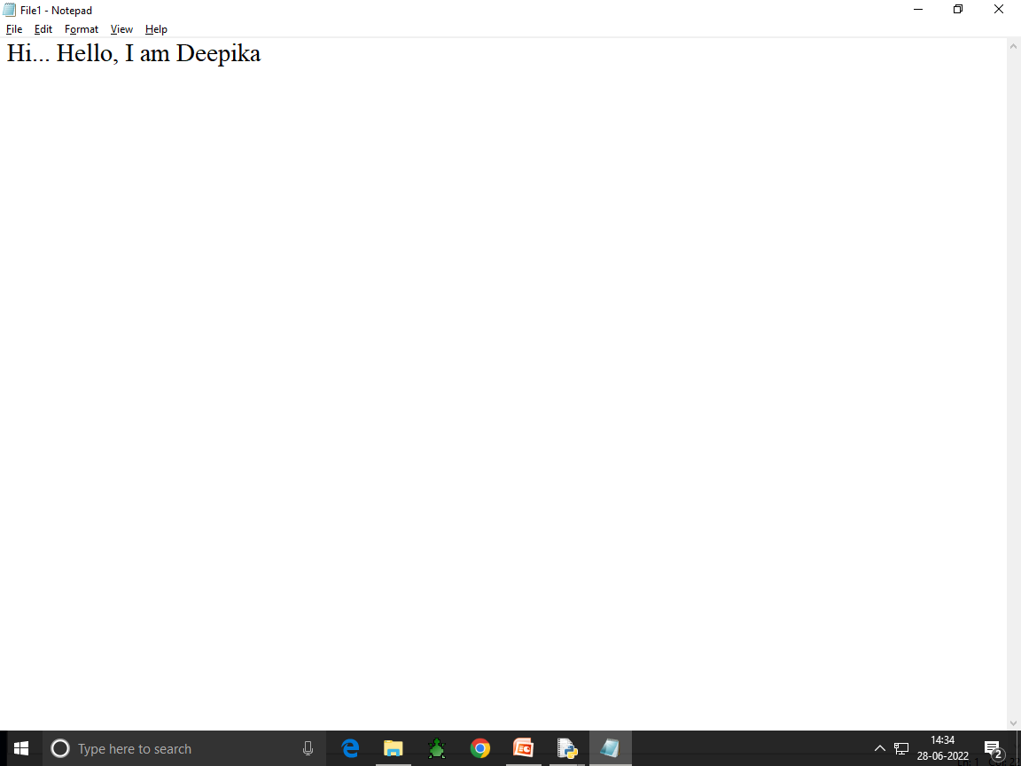

Slide 17
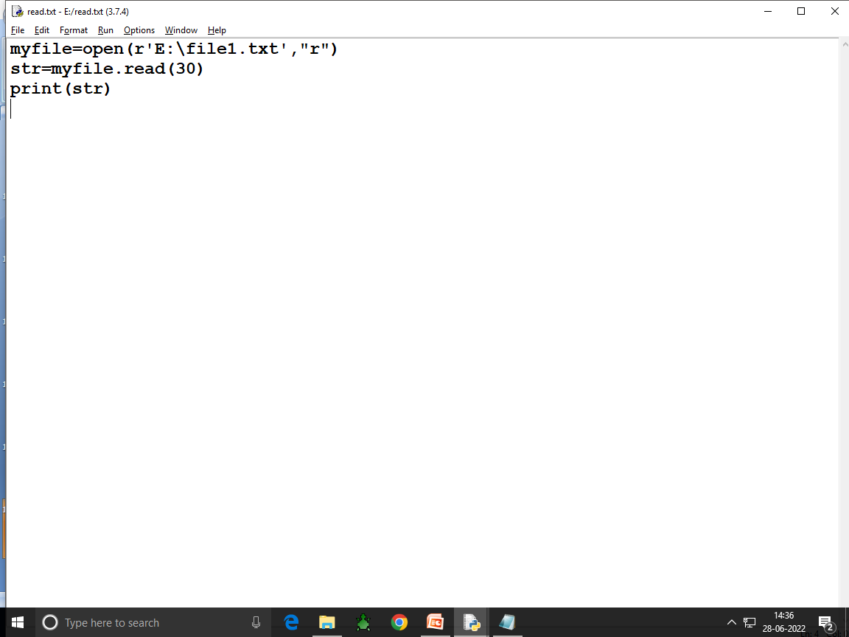

Slide 18
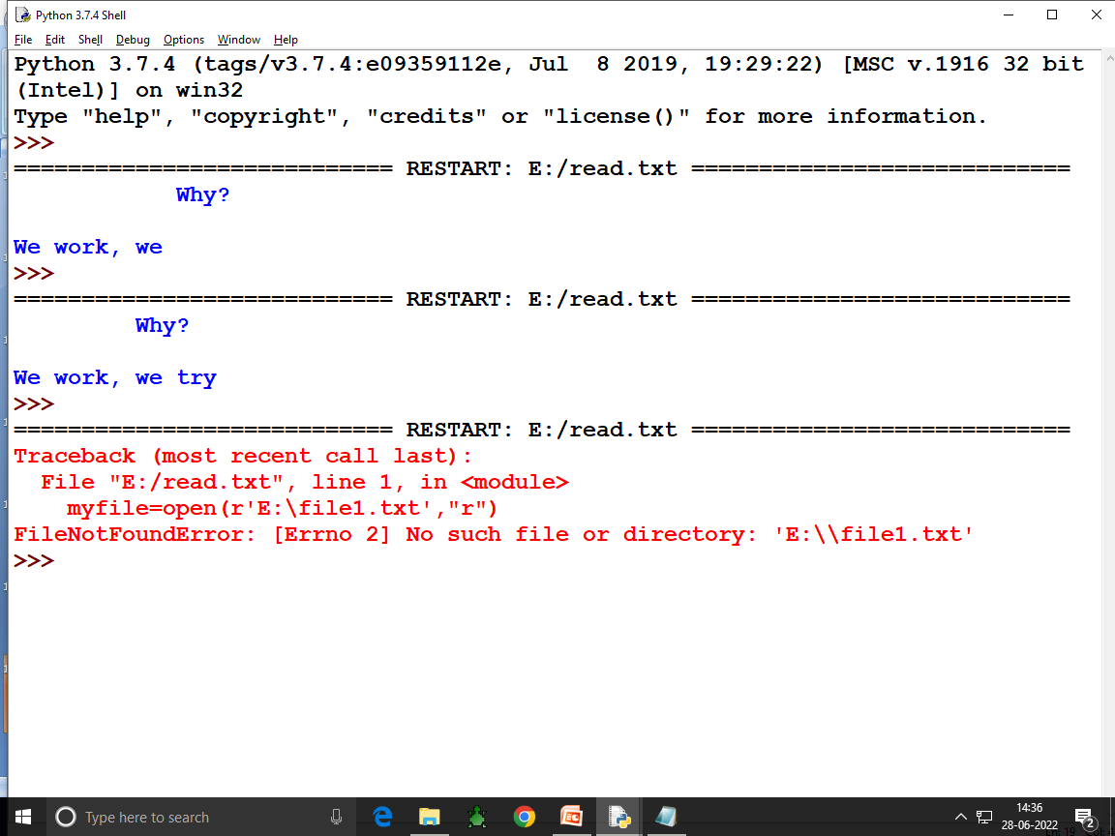

Slide 20
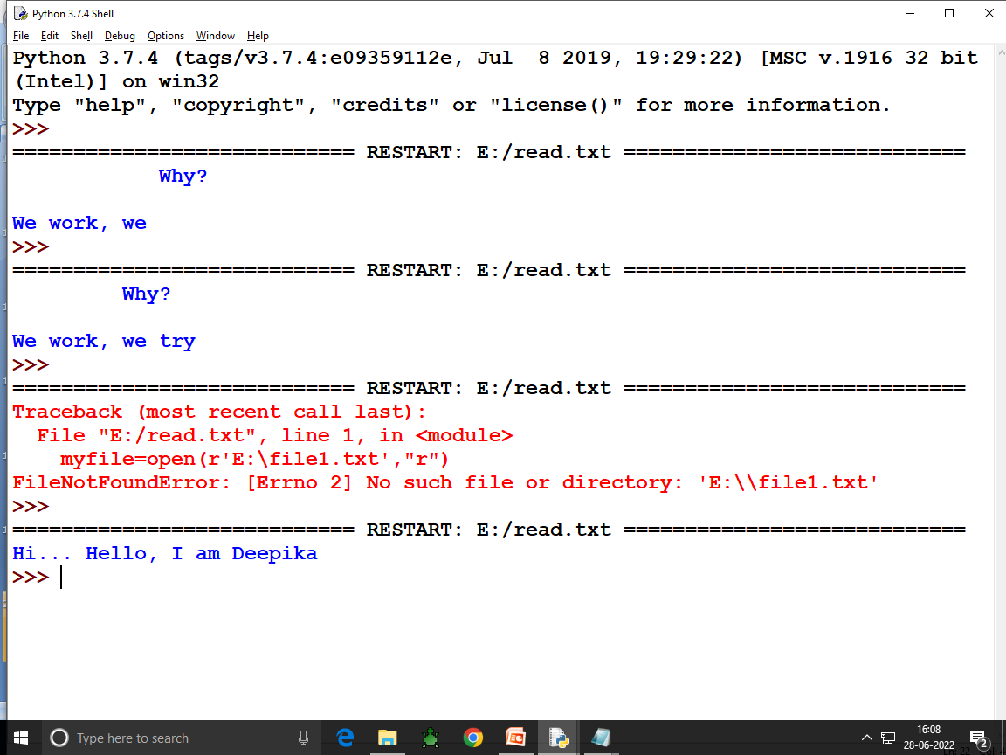

Slide 22
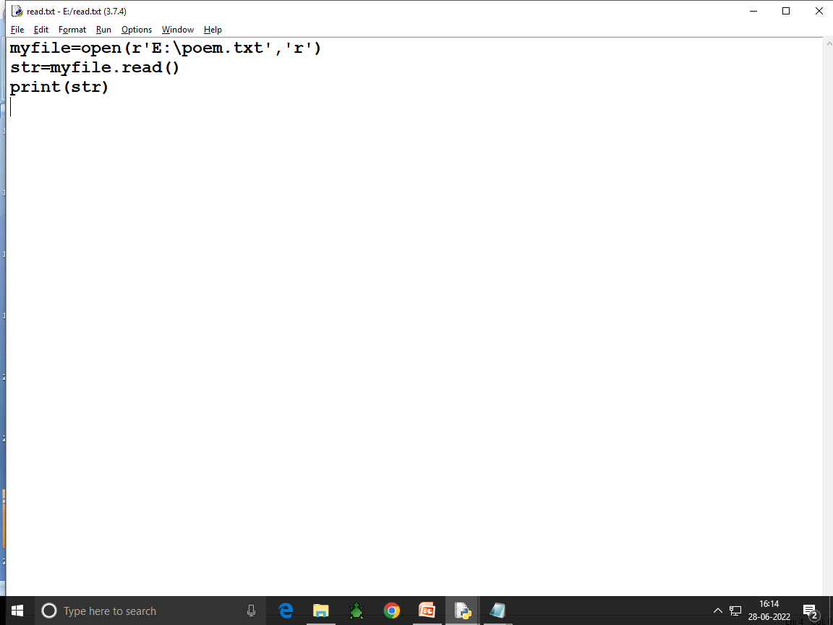

Slide 23
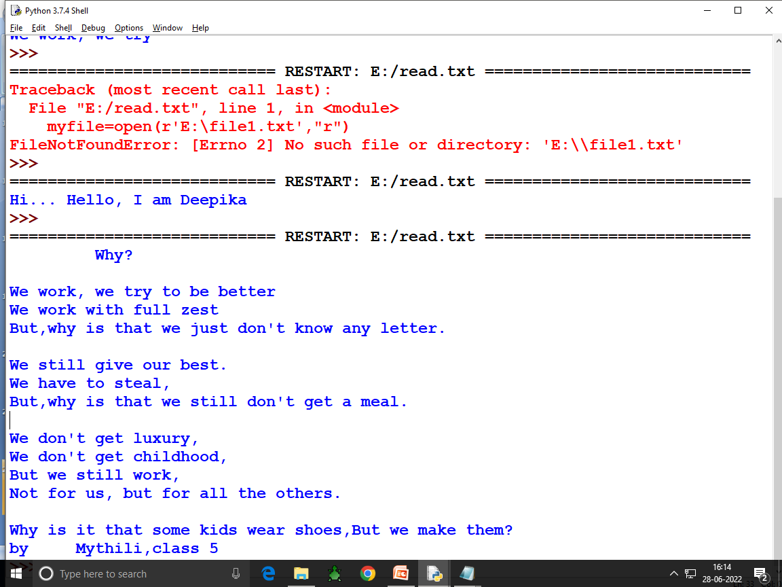

Slide 24
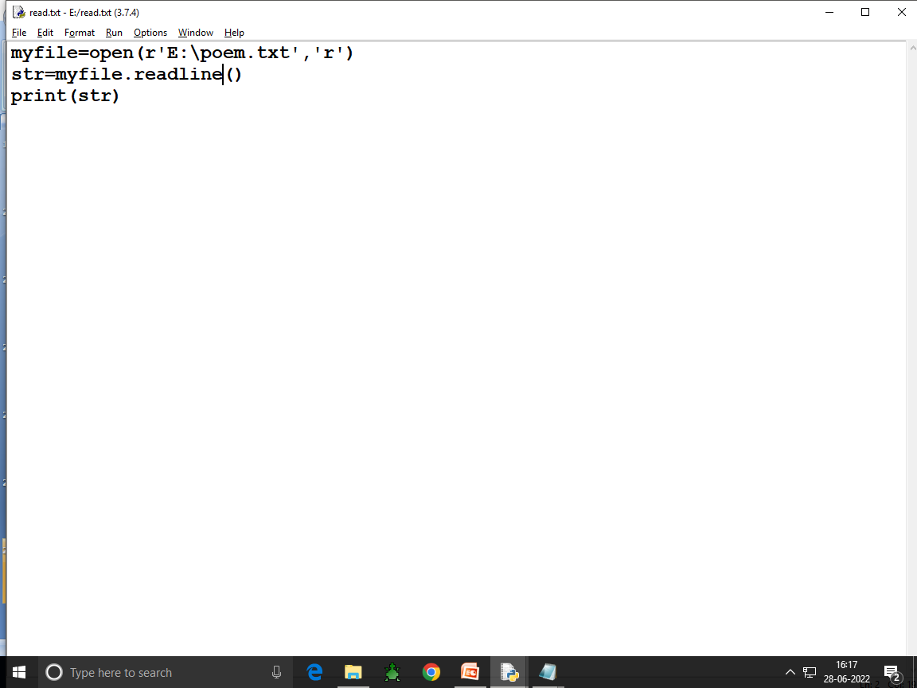

Slide 25
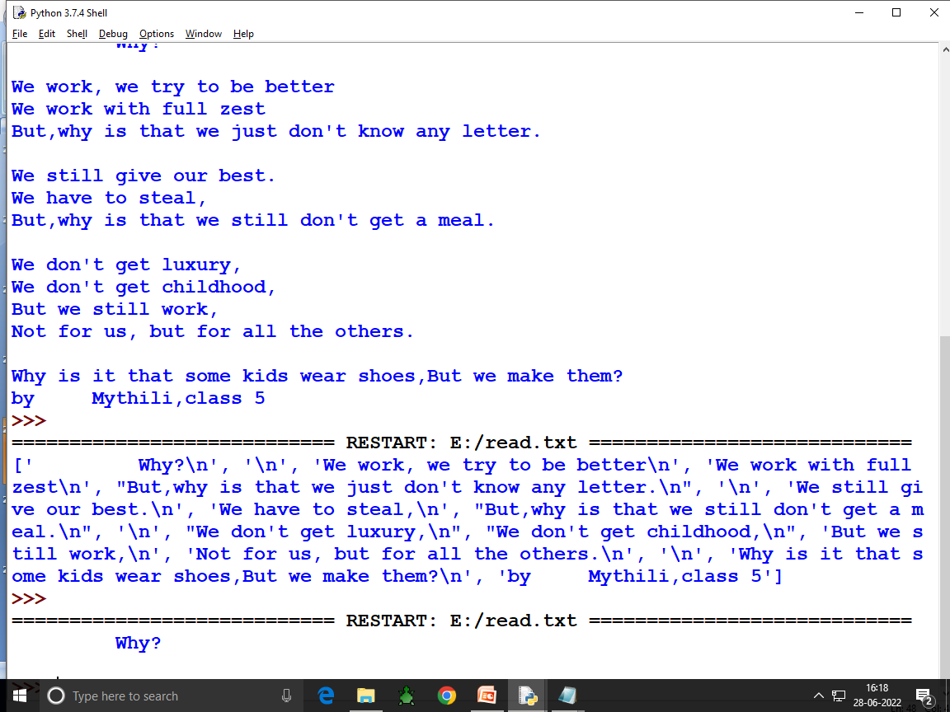

Slide 26
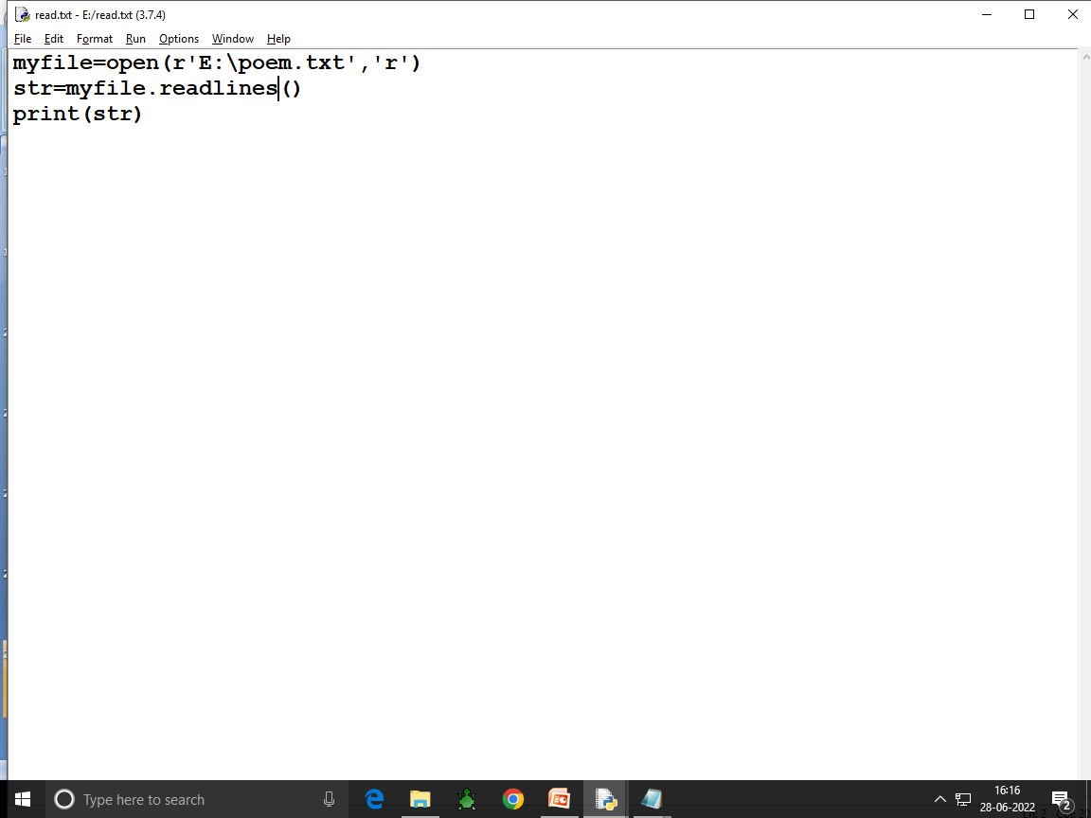

Slide 27
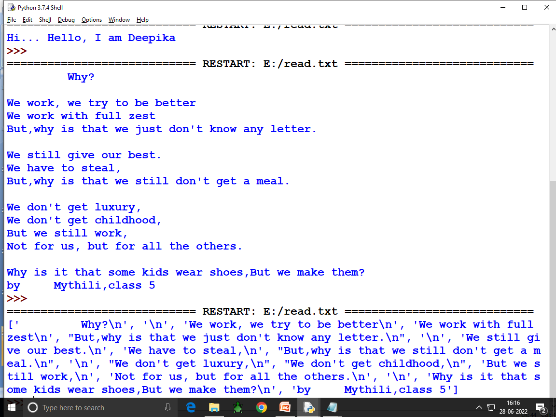

Slide 28
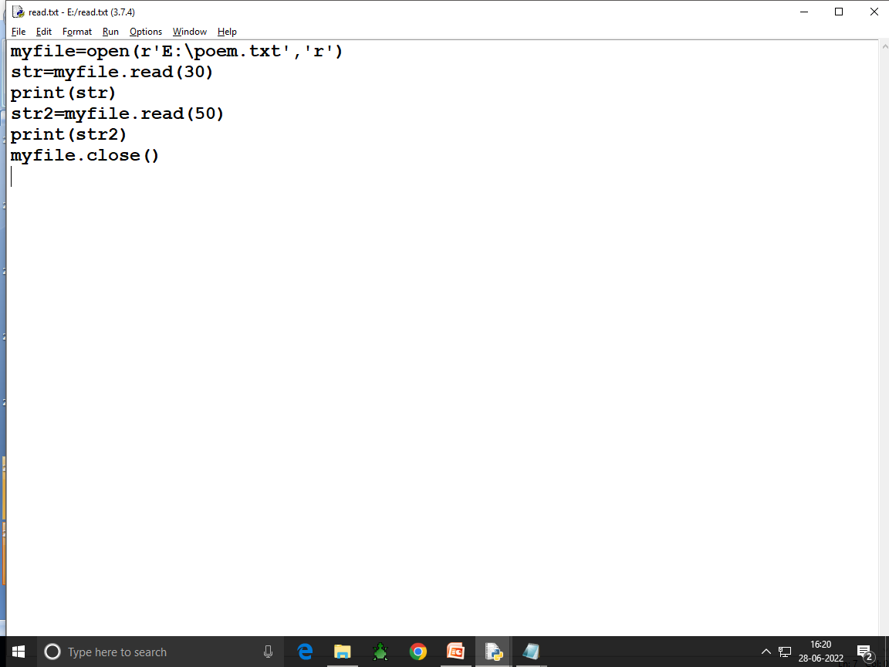

Slide 29
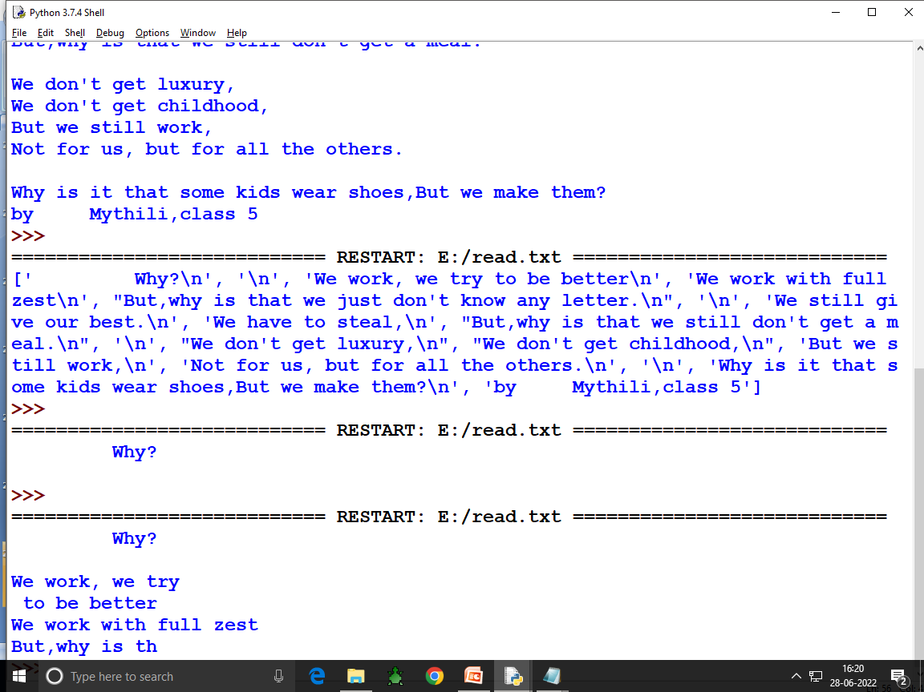

Slide 30
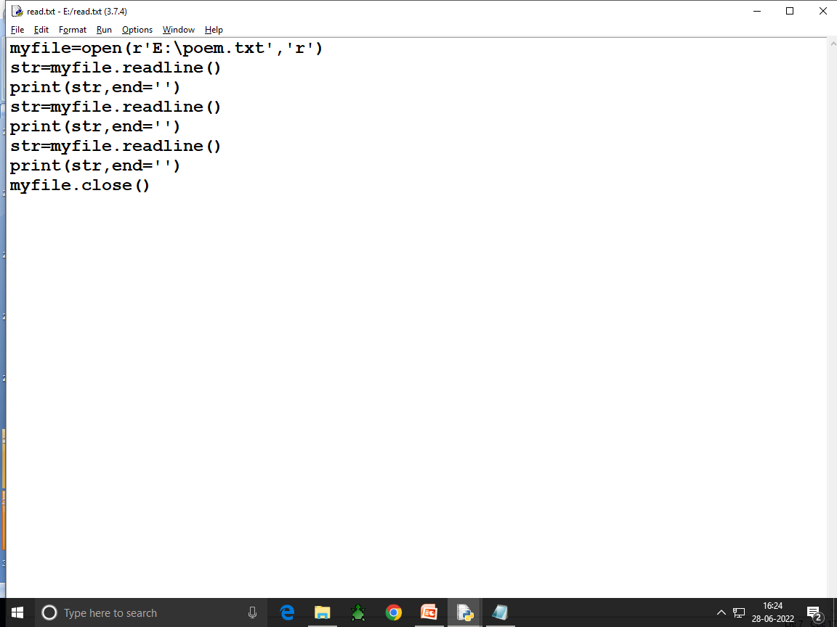

Slide 31
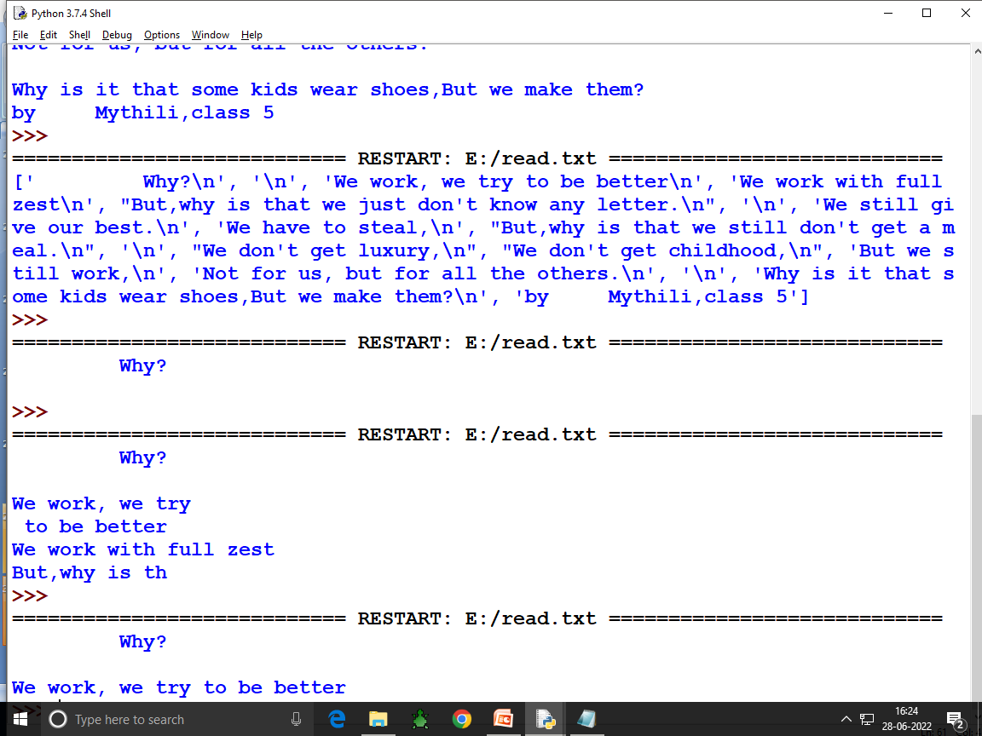

Slide 32
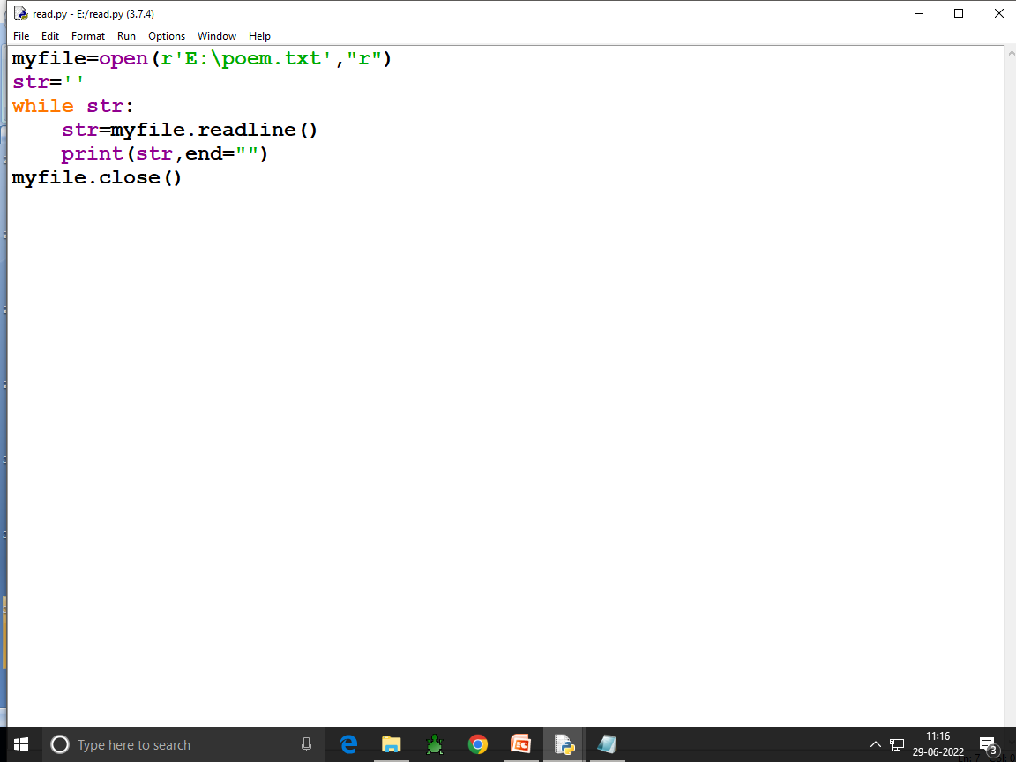

Slide 33
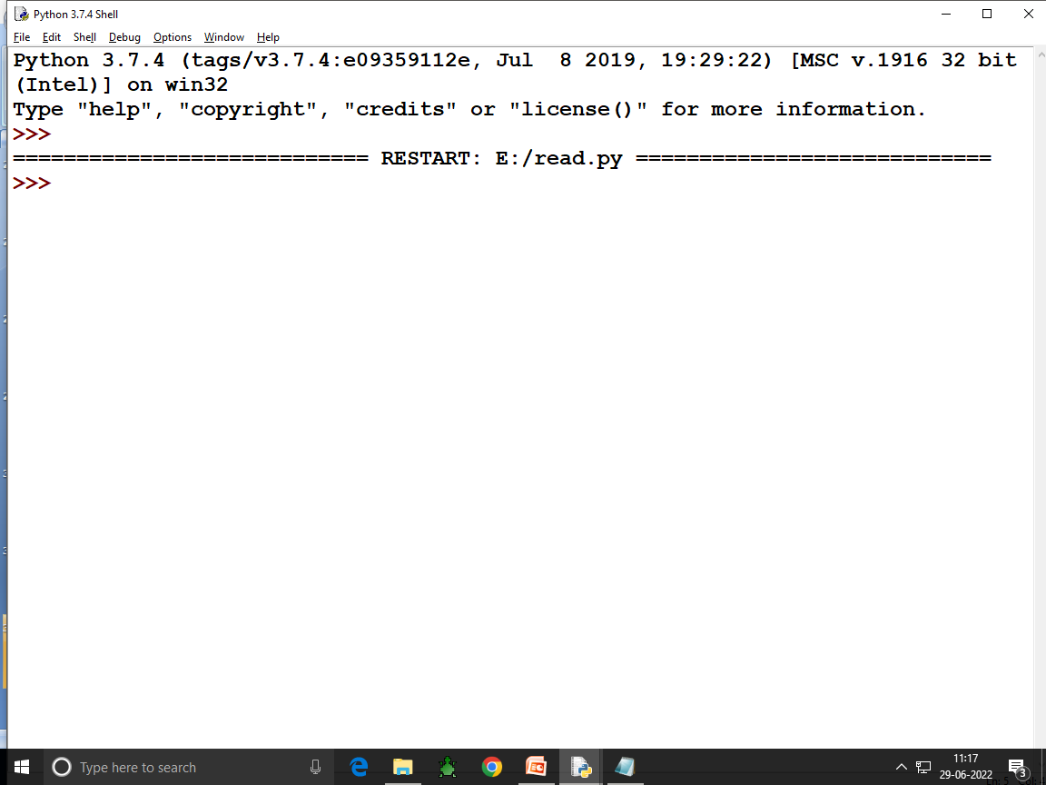

Slide 34
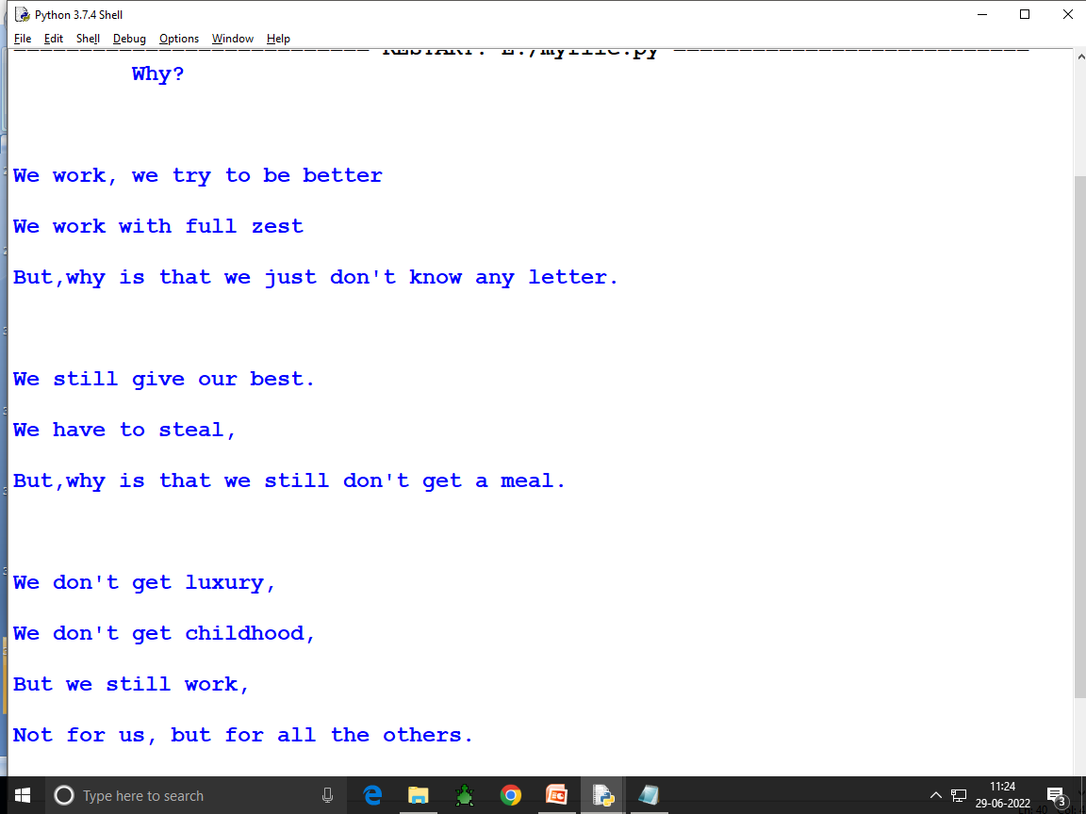

Slide 35
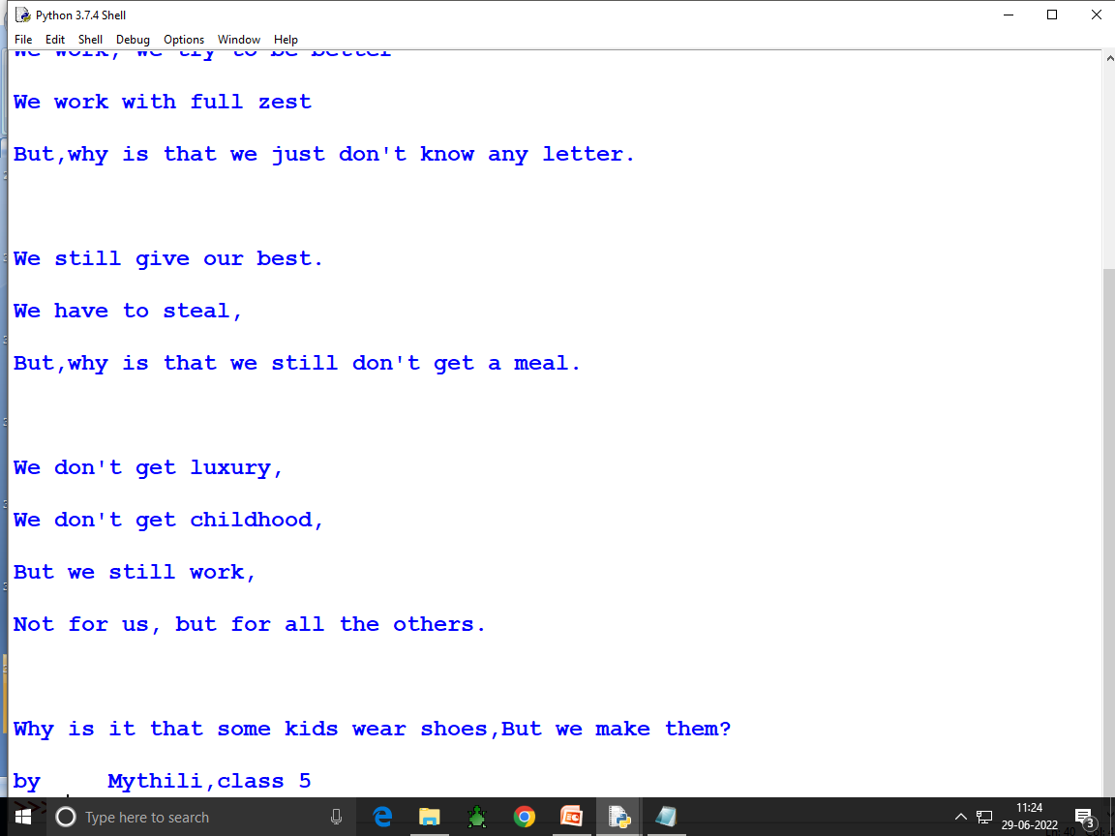

Slide 36
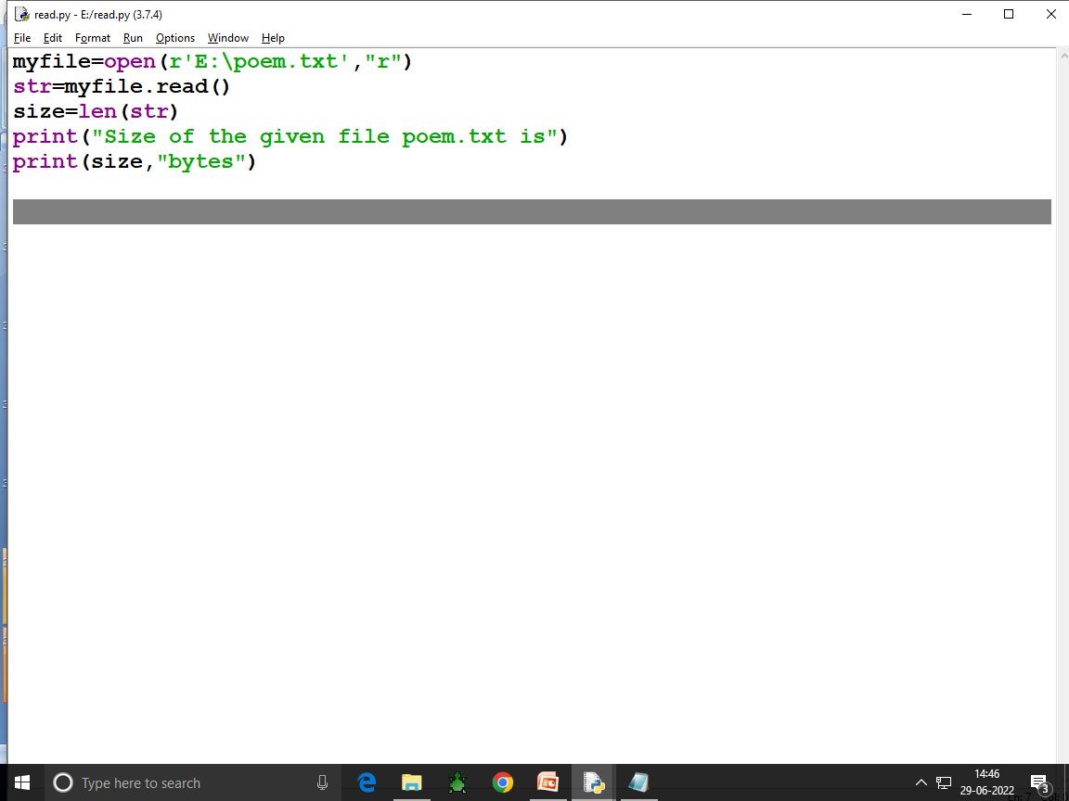

Slide 37
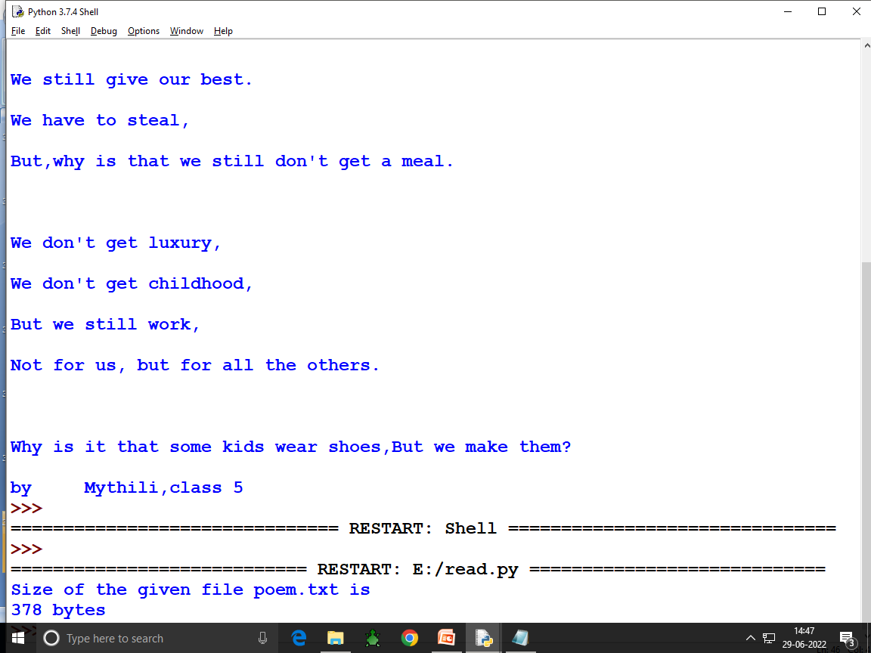

Slide 38
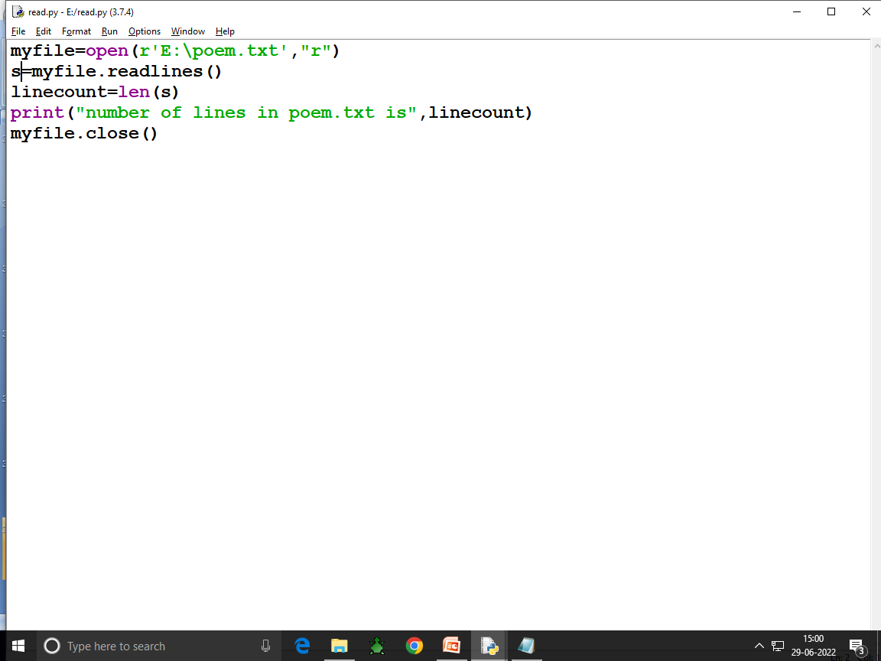

Slide 39
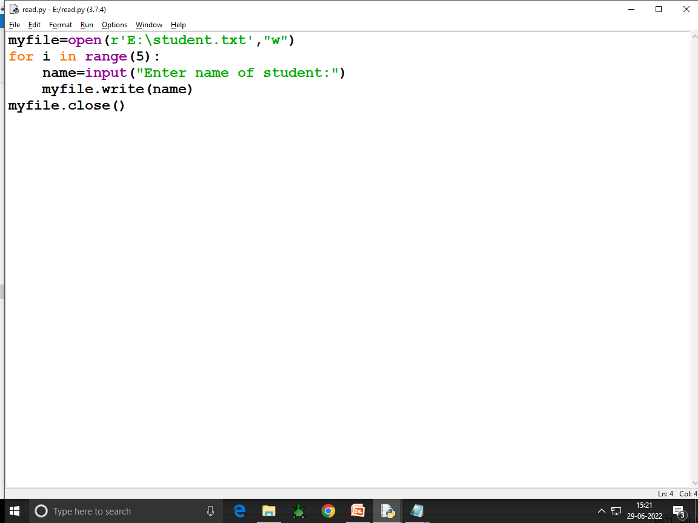

Slide 40
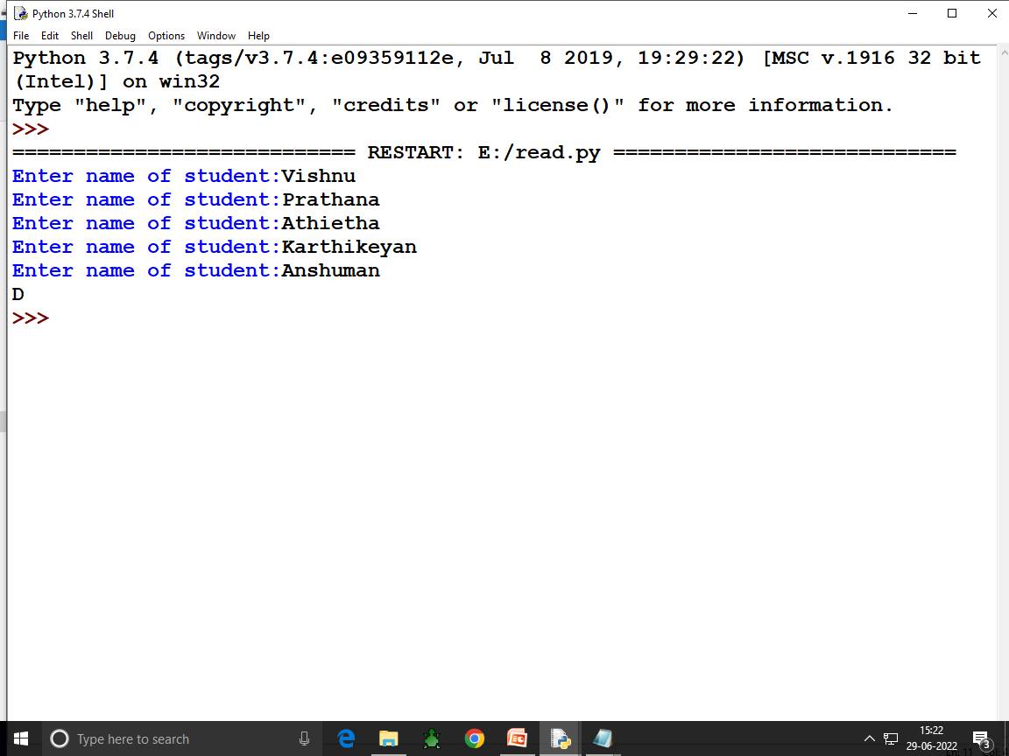

Slide 41
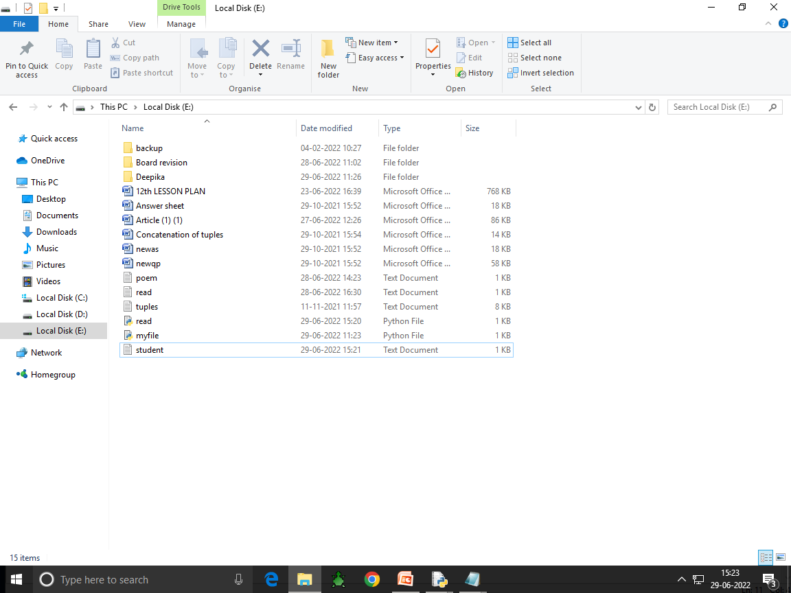

Slide 42
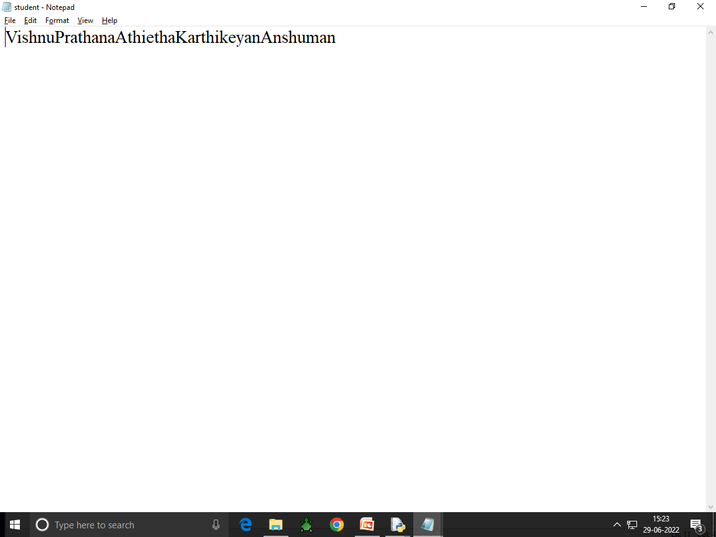
jjjjjjjjjjjjjjjjjjjjjjjjjjjjjjjjjjjjjjjjjjjjjjjjjjjyu6755555555555555555555

Slide 43
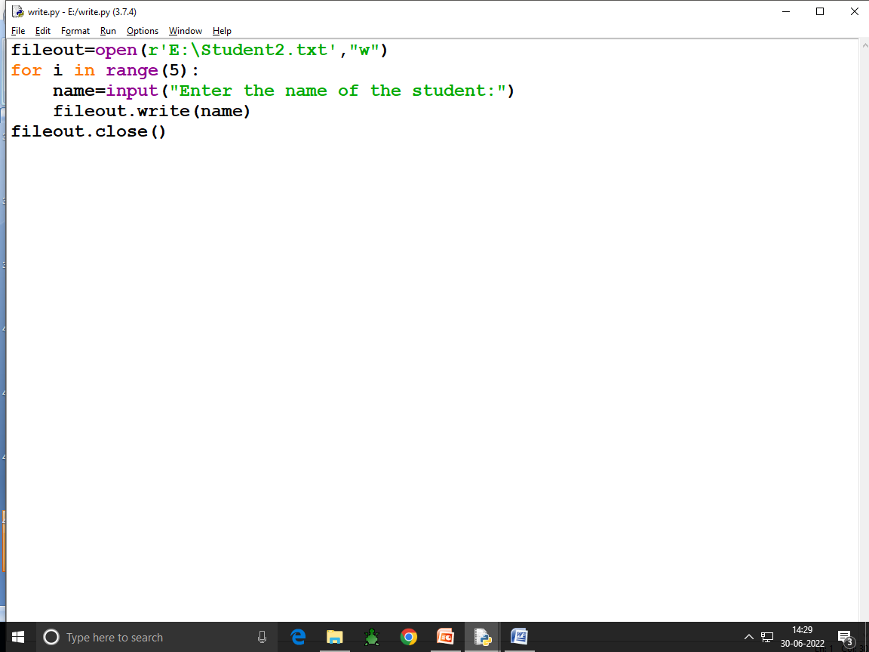

Slide 44
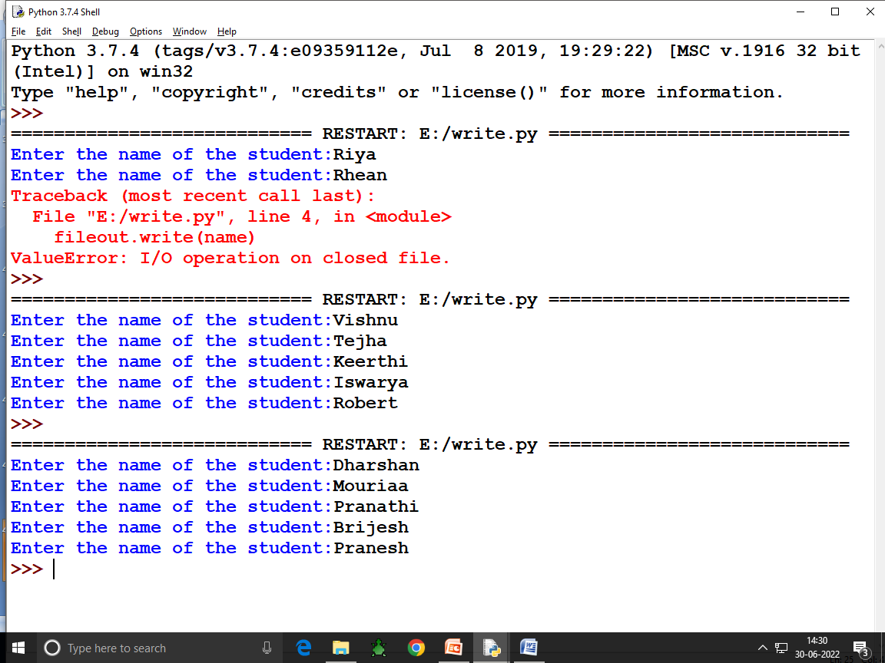

Slide 45
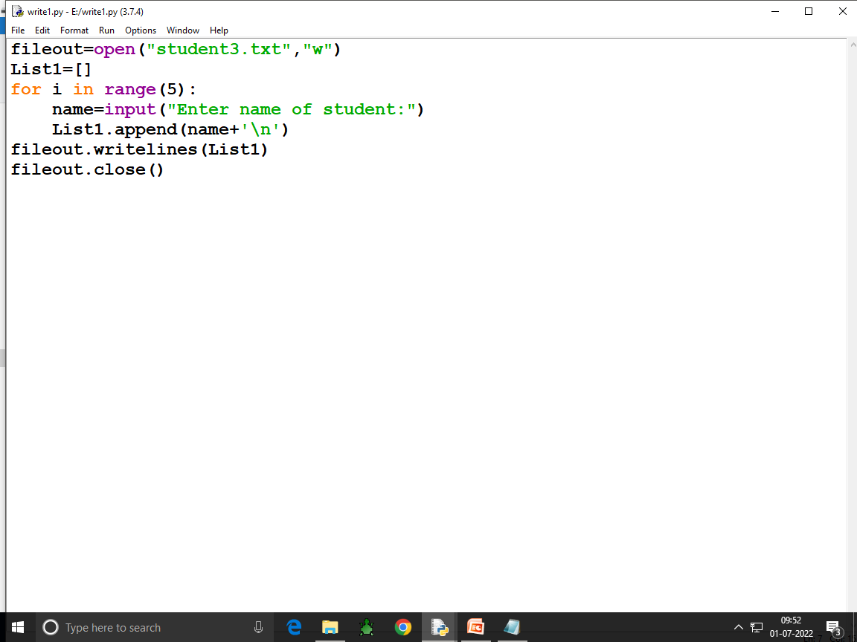

Slide 46
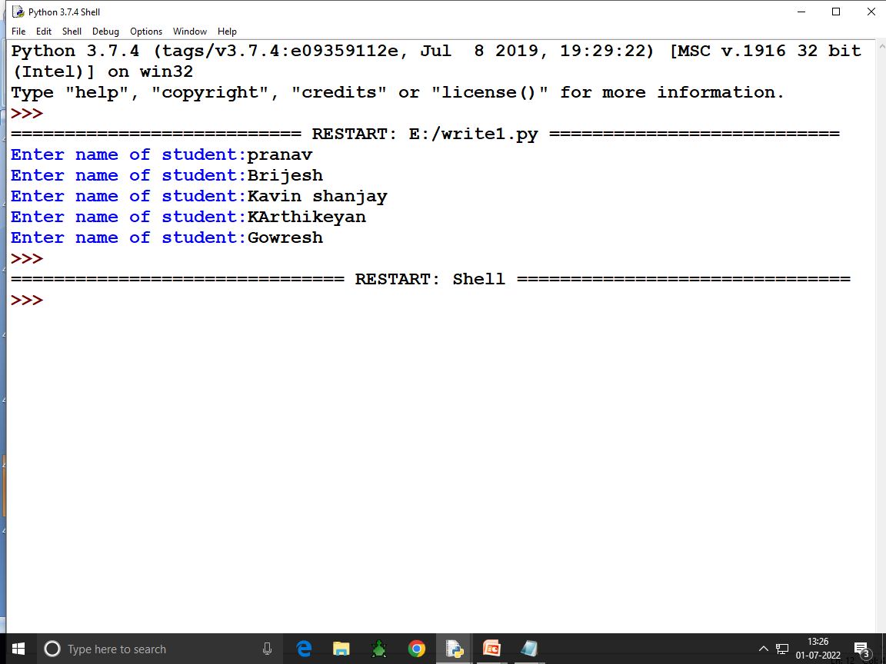

Slide 48
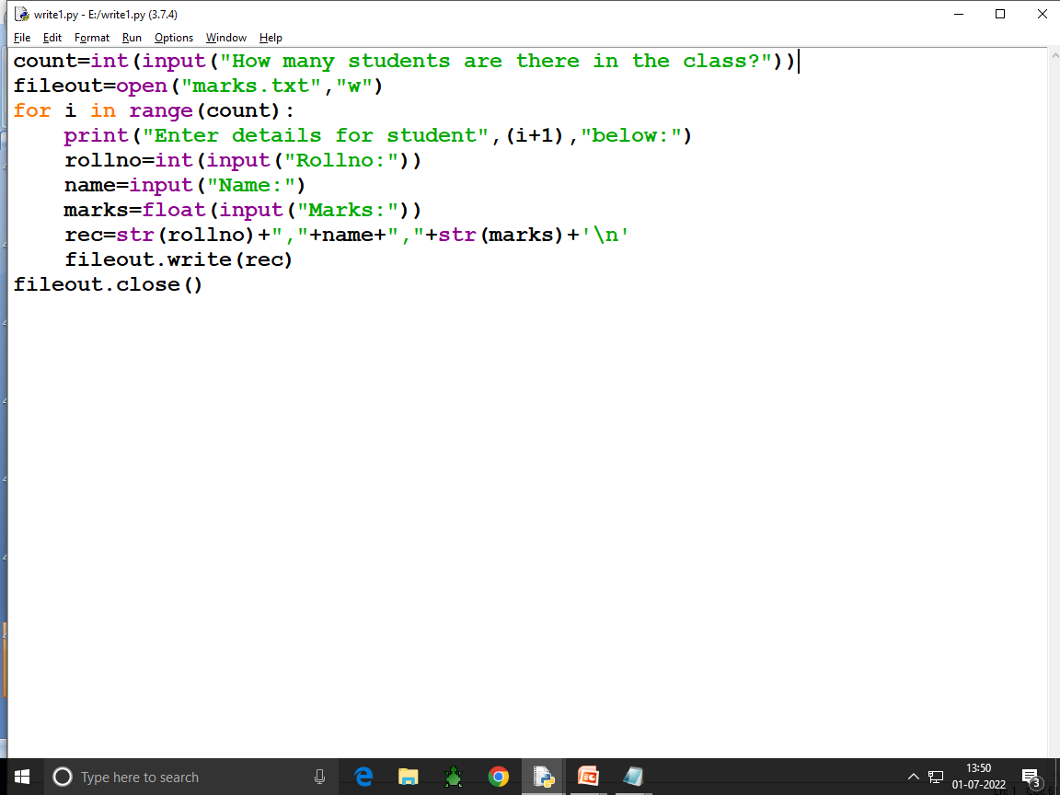

Slide 49
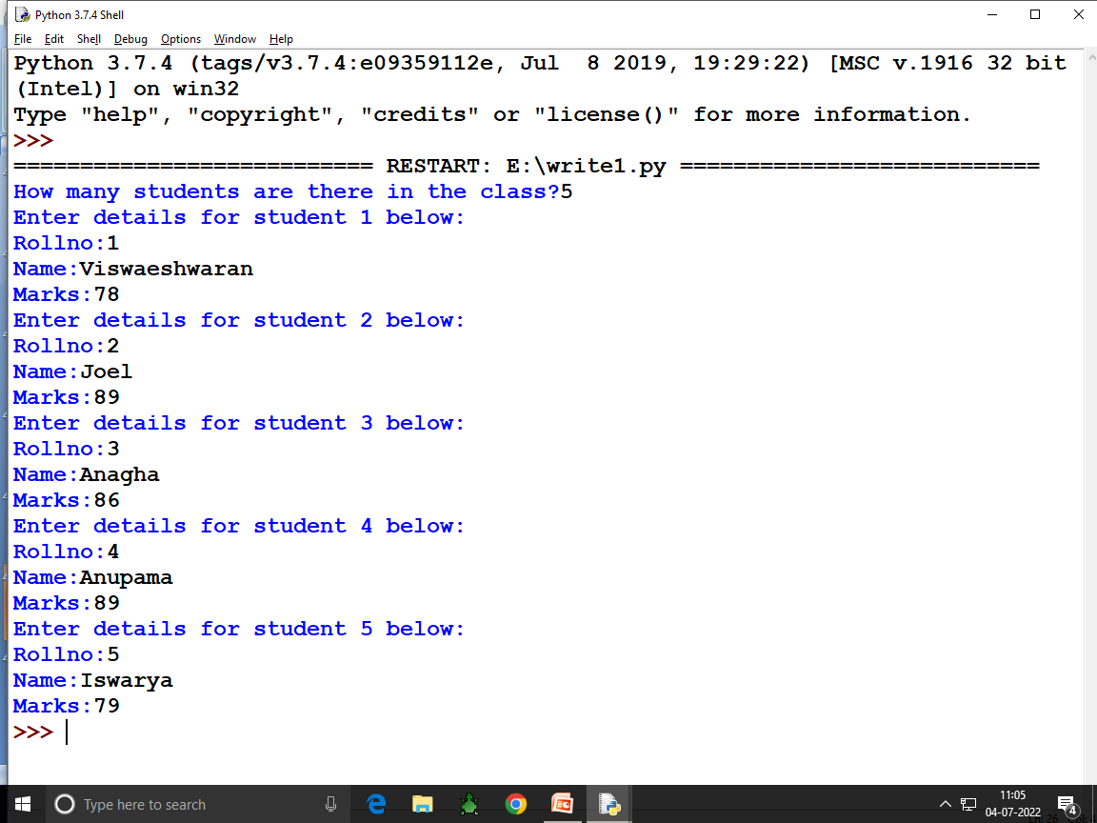

Slide 50
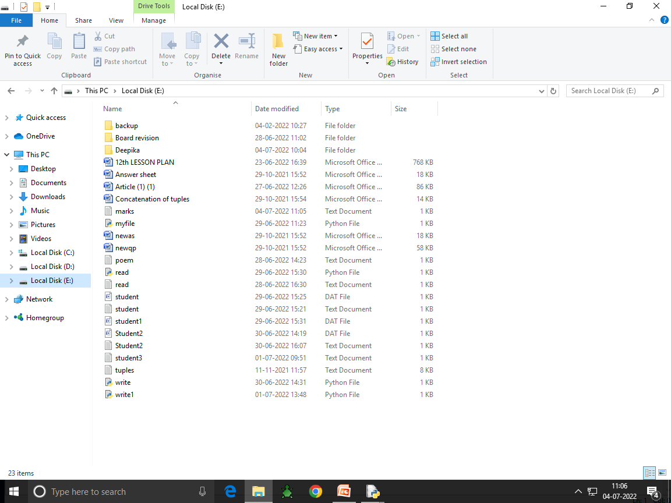

Slide 51
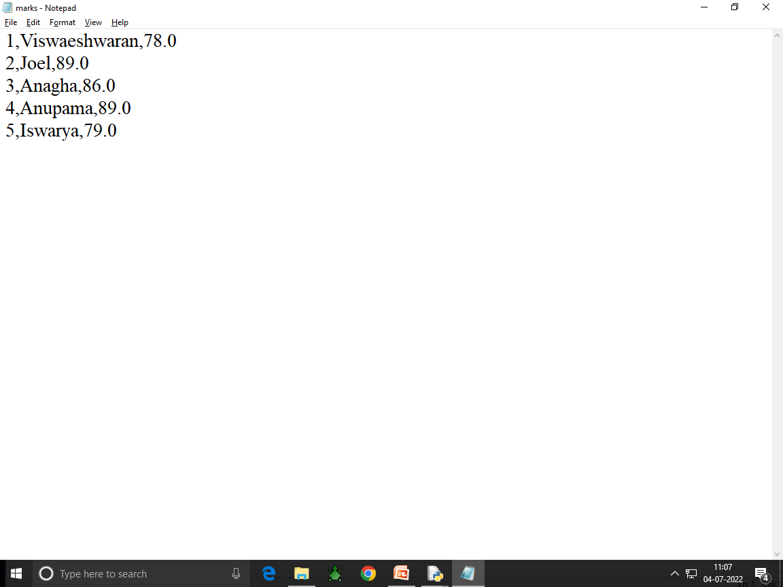

Slide 52
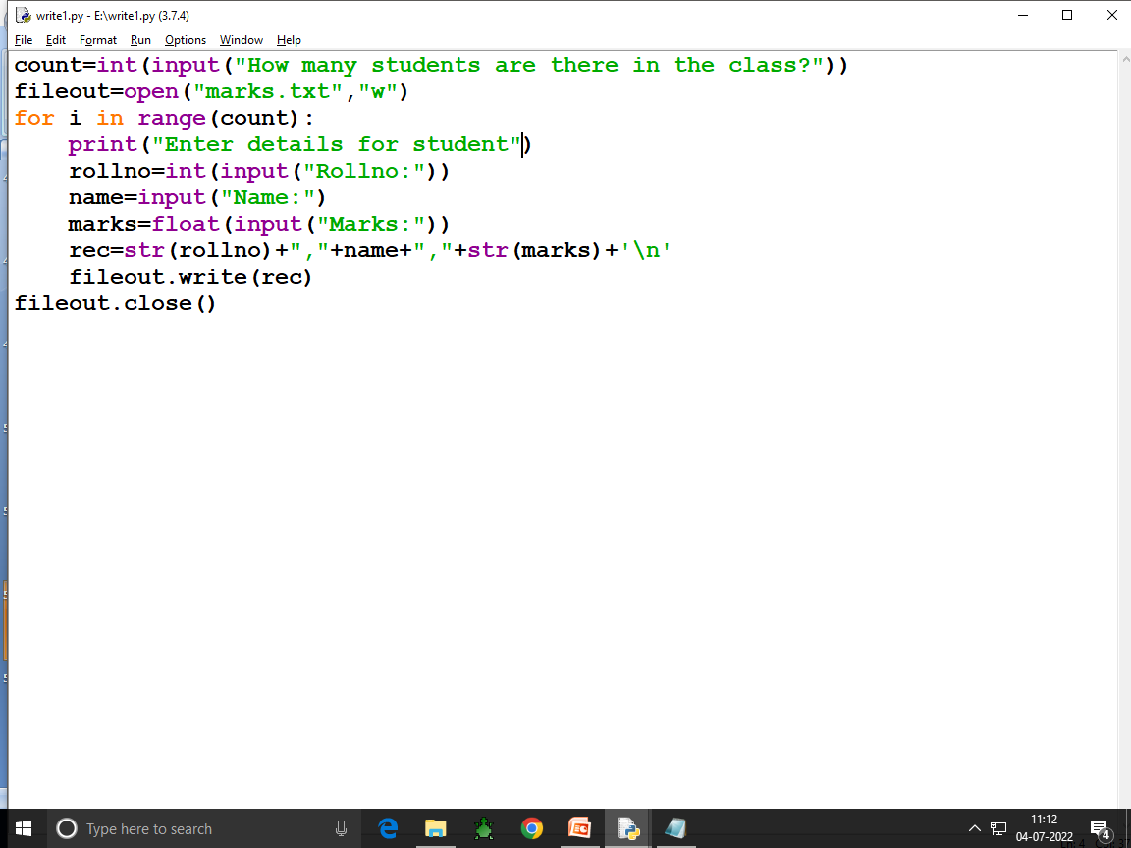

Slide 53
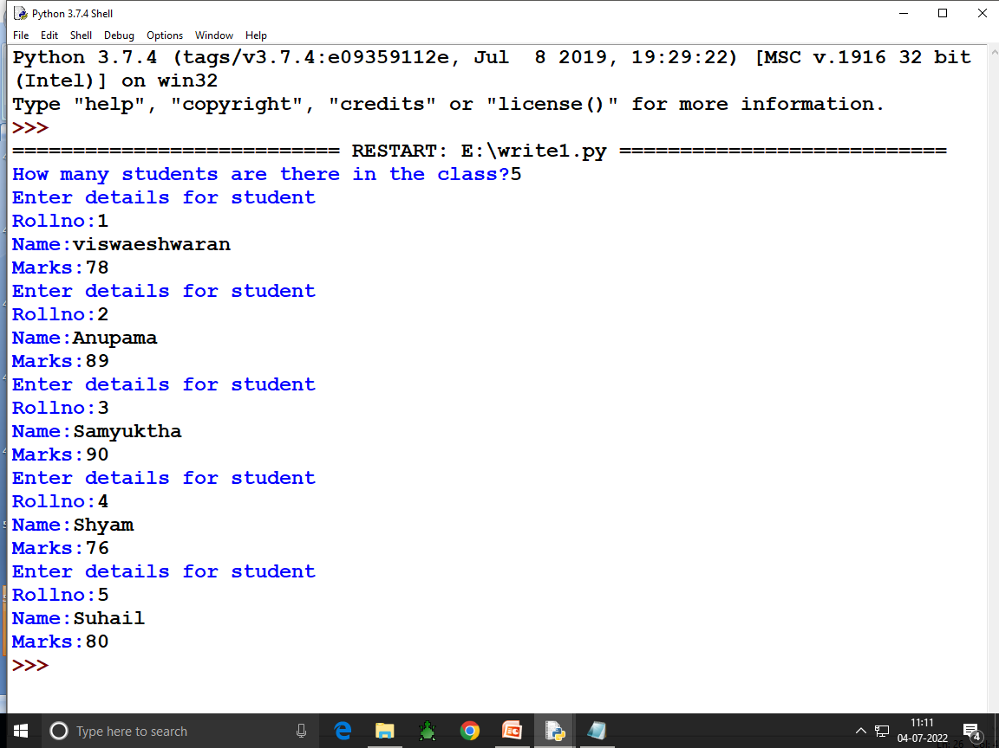

Slide 54
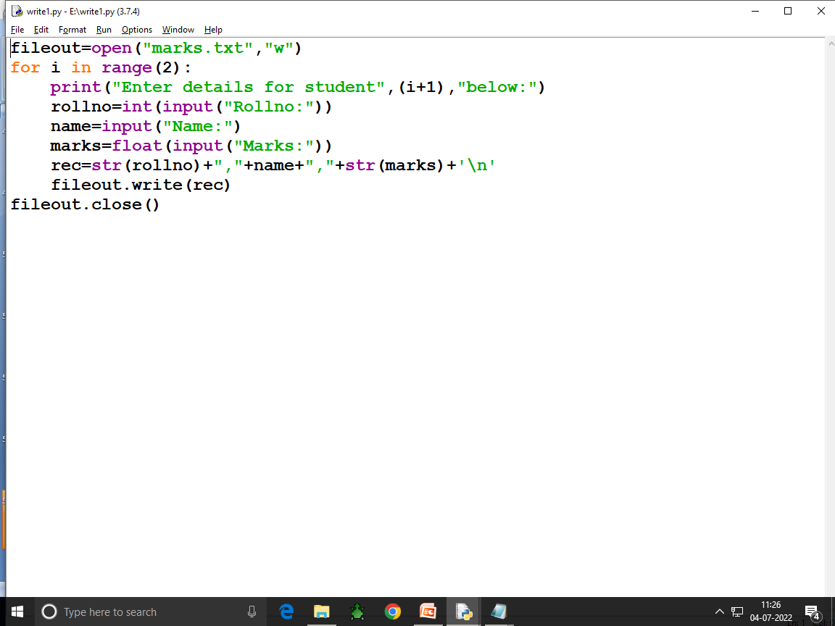

Slide 55
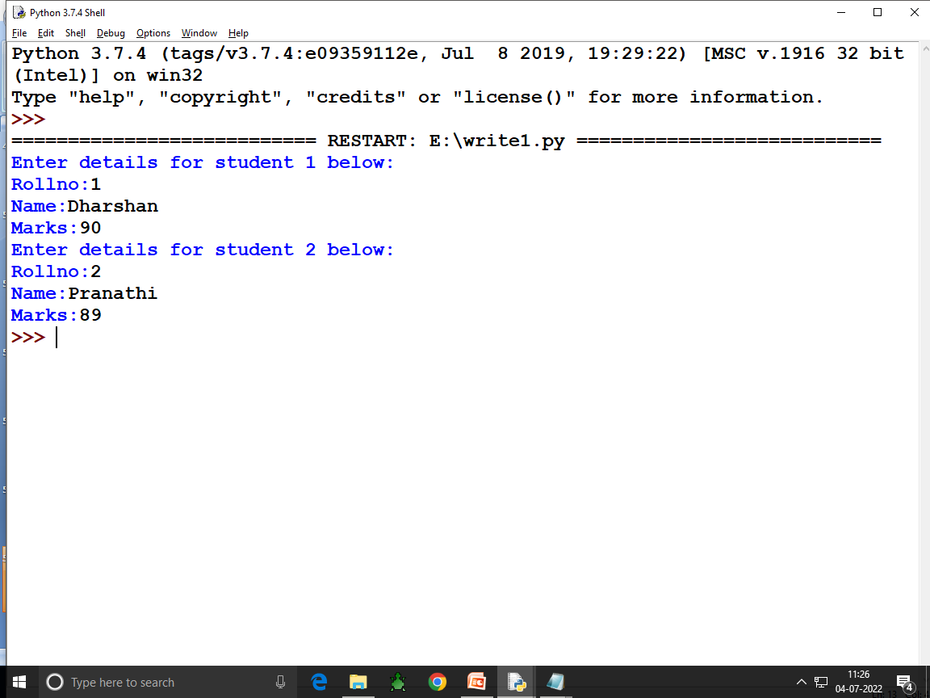

Slide 57
The flush() function forces the writing of data on disc still pending in output buffer The flush() method in Python file handling clears the internal buffer of the file. In Python, files are automatically flushed while closing them. However, a programmer can flush a file before closing it by using the flush() method. This method does not require any parameters and it does not return anything.

Slide 58
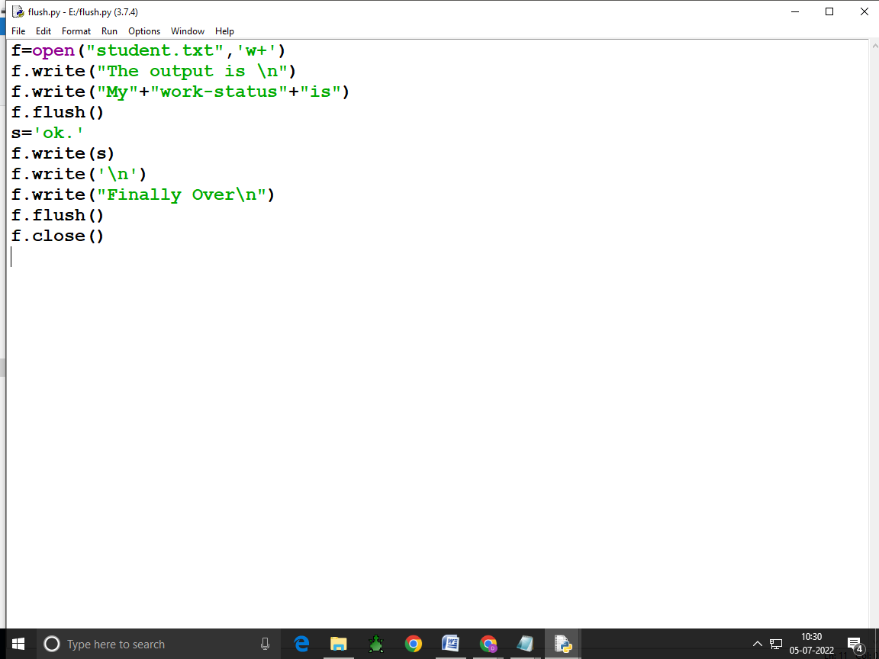

Slide 59
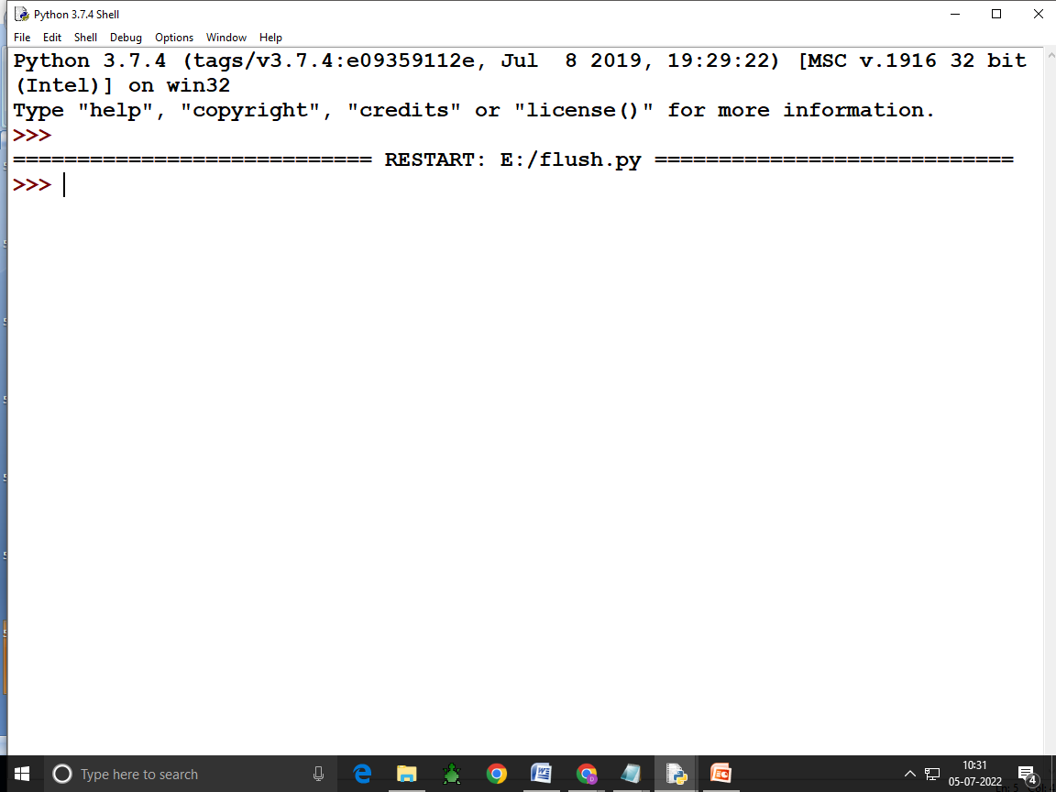

Slide 60
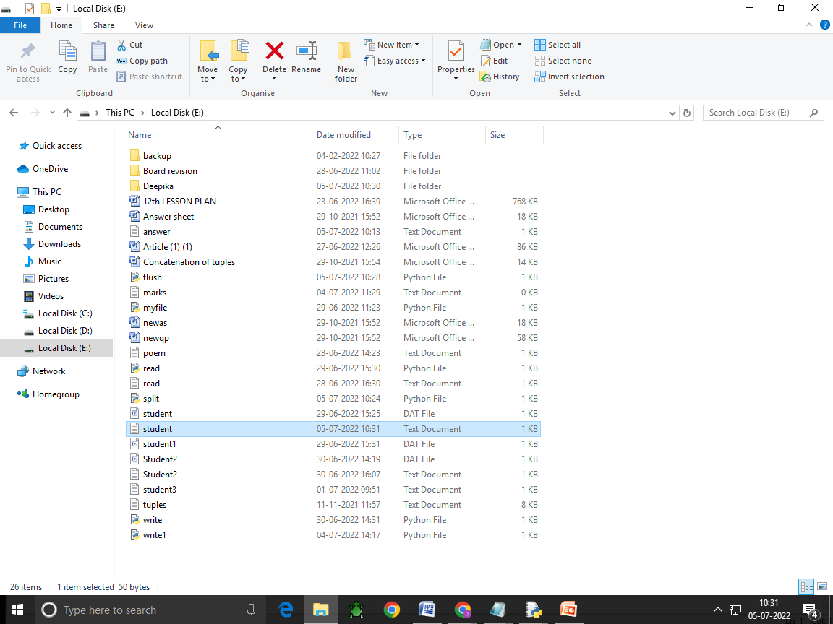

Slide 61
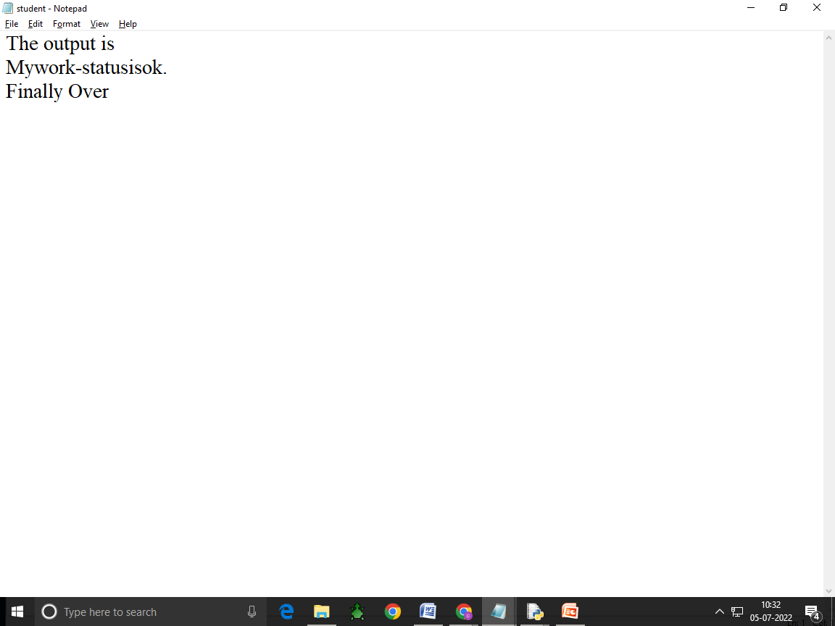

Slide 62
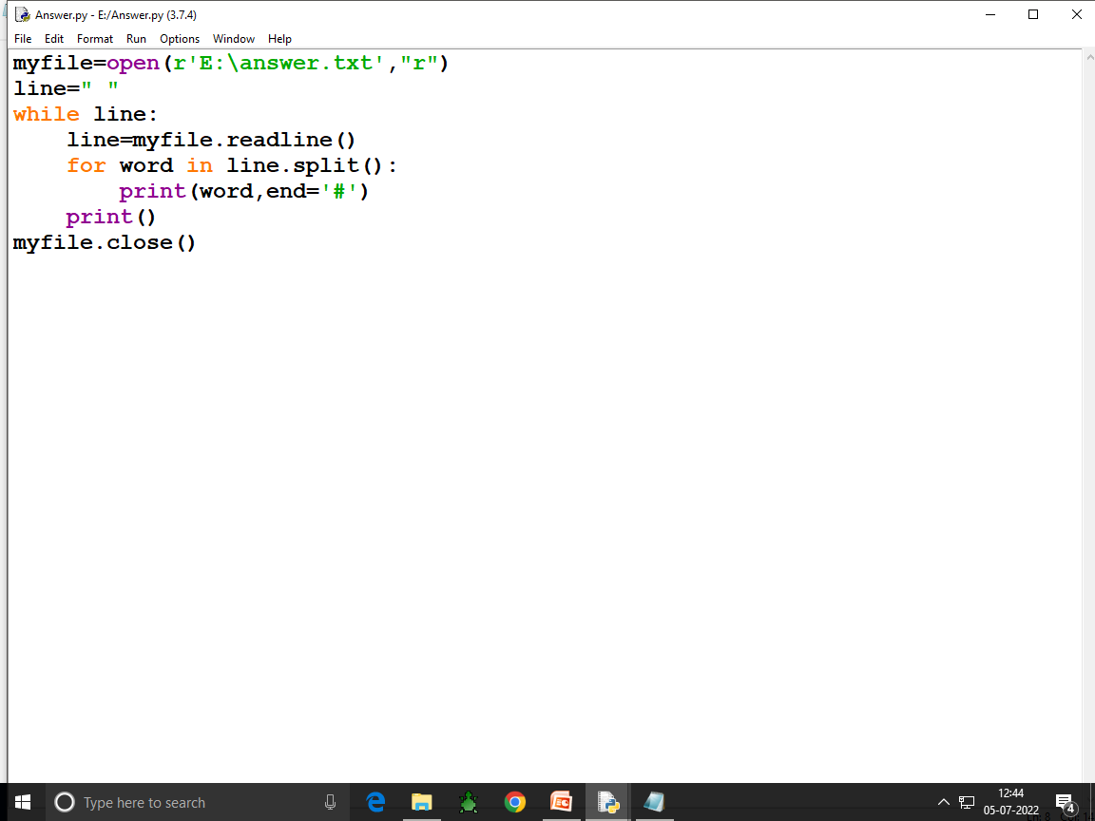

Slide 63
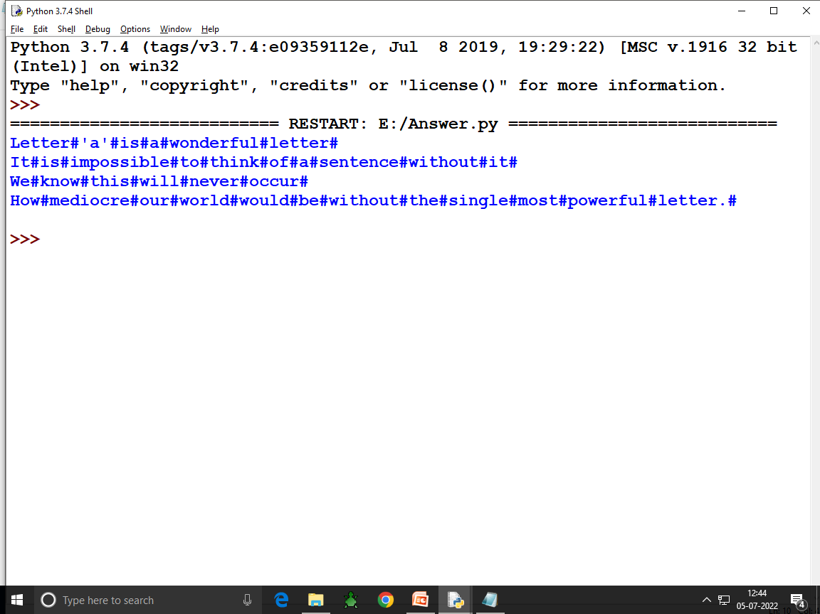

Slide 64
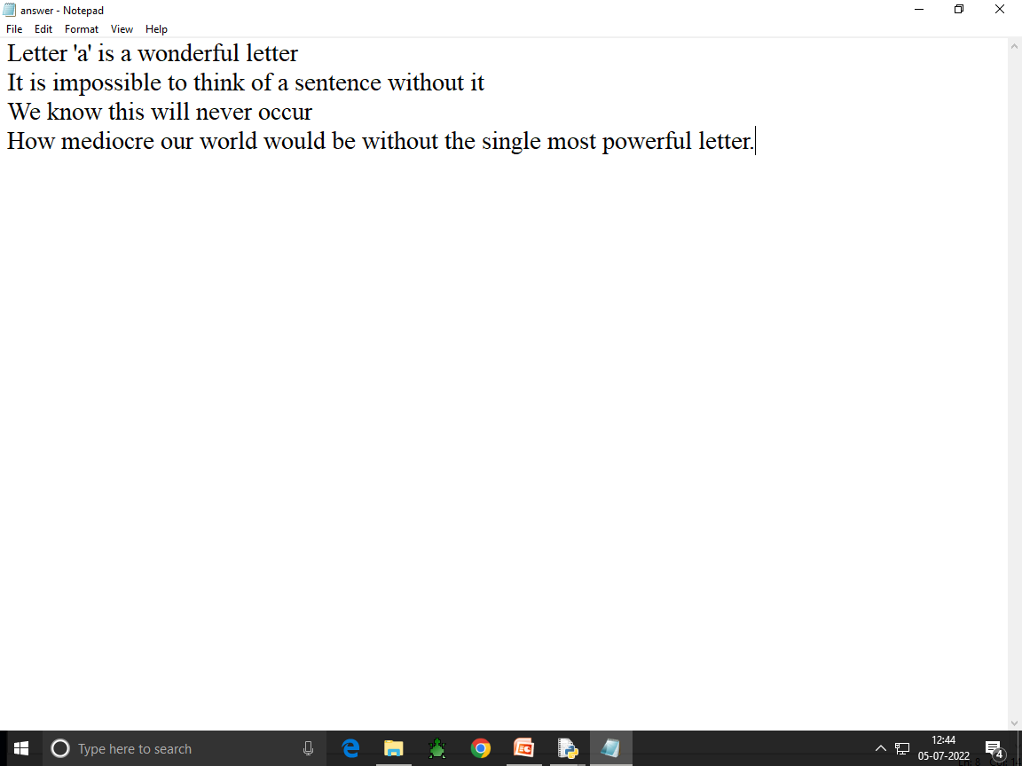

Slide 65
File Pointer: Every file maintains a file pointer which tells the current position in the file where writing or reading will take place. A file pointer in this context works like a book mark in a book.

Slide 66
Whenever you read something from the file or write onto a file,then these two things happen involving file pointer: (i) This operator takes place at the position of file pointer. (ii) File pointer advances by the specified number of bytes. A file pointer stores the current position of a read or write within a file. All operations within the file are made with reference to the pointer. The data type of this pointer is defined in stdio. h and is named FILE. Eg:BOOKMARK

Slide 67
Standard input,output and error streams Input-The keyboard Output-The monitor if any error if occurs is also displayed on the monitor.So the monitor is also standard error device. Standard input device(stdin)-reads from the keyboard. Standard Output device(stdout)-prints to the display and can be redirected as standard input. Standard error device(stderr)-Same as stdout but normally only for errors.Having error output separately allows the user to divert regular output to a file and still be able to read error messages.

Slide 68
Standard Input,Output Devices as Files: sys.stdin.read() -> read from keyboard -> Standard input device -> sys.stdin. sys.stdout.write() -> from monitor -> Standard output devices ->sys.stdout. For eg: fh=open(r”E:\poem.txt”) line1=fh.readline() line2=fh.readline() sys.stdout.write(line1) sys.stdout.write(line2) sys.stderr.write(“No errors occurred\n”)

Slide 69
Output: WHY? We work, we try to be better No errors occured.

Slide 70
Absolute and Relative Paths: All the drives are Absolute paths. All the sub folders are called relative paths.

Slide 71
Working with Binary Files It is important that they are stored in way so that their structure/hierarchy is maintained.For this purpose,objects are often serialized and then stored in binary files. Serialisation(also called Pickling): It is the process of converting python object hierarchy into byte stream so that it can be written into a file.Pickling converts an object in byte stream in such a way that it can be reconstructed in original form when unpickled or deserialised. Unpickilng: It is the inverse of pickling where a byte stream is converted into an object hierarchy .Unpicking produces the exact replica of the original object.

Slide 72
Pickle module for reading and writing objects in binary files. Import pickle dump() -> for write load() -> for read Steps for doing the program: 1.import pickle module. 2.Open binary file in the required file mode(read and write mode) 3.process binary file by writing/reading objects using pickle module’s methods. 4.once done,close the file.

Slide 73
Creating/Opening/Closing Binary Files: A binary file is opened in the same way as you open any other file but make sure to use ‘b’ with file modes to open a file in binary mode. Dfile=open(“stu.dat”,”wb+”) or File1=open(“stu.dat”,”rb+”)

Slide 74
W,W+,a =? How to close a file=?

Slide 75
Writing onto a Binary File-Pickling pickle.dump(<object-to-be-written>,<file handle-of –open –file>) pickle.dump(list1,file1) object list1 is being written on file opened with file handle as File1 pickle.dump(student1,file2) object student1 is being written on file opened with file handle as File2

Slide 82
To append data in binary follow these steps: Open the file in append mode using “ab” Ex.: f = open (“file. dat”,”ab”) Declare list object to store data which is going to be appended. Enter data to append. Append entered data into the declared list object. Use pickle. dump() method to write the list data. Close the file.

Slide 83
To append records in a binary file,make sure to open the file in append mode(“ab” or “ab+”).

Slide 86
1.The try block lets you test a block of code for errors. 2.The except block lets you handle the error. 3.The else block lets you execute code when there is no error.

Slide 95
The Tell() Function The tell() function returns the current position of file pointer in the file.It is used as per the following syntax: <file-object>.tell() where file-object is the handle of the open file,eg:if the file is opened with handle fin,then fin.tell() will give you the position of file pointer in the file opened with the handle fin.

Slide 102
The Seek() Function: The seek() function changes the position of the file pointer by placing the file-pointer at the specified position in the open file. Syntax: <file-object>.seek(offset[,mode]) offset->is a number specifying number-of-bytes mode-> is a number 0 or 1 or 2 signifying 0 for beginning of file.It is default position 1 for current position of file-pointer. 2 for end of file. File object: is the handle of open file.

Slide 103
Fh=open(“Marks.txt”,”r”) # It will place the file pointer at 30 byte from the beginning of the file(default) fh.seek(30) #It will place the file pointer at 30th byte ahead of current file pointer position (mode=1)

Slide 104
Forward direction: With positive value for bytes. Backward direction: By giving negative value for bytes.

Slide 110
The CSV files are popular because of these reasons: (i) Easier to create (ii)Preferred export and import format for databases and spreadsheets (iii) Capable of storing large amounts of data. The separator character of CSV files is called a delimiter.Default and most popular delimiter is comma,Other popular delimiters include the tab(\t),colon(:),pipe(|) and semi-colon(;) characters.

Slide 111
CSV FILES CSV stands for Comma Separated Values. CSV is just like a text file.,in a human readable format which is extensively used to store tabular data,in a spreadsheet or database. The separator character of CSV files is called a delimiter.Default delimiter is comma(,).Other delimiters are tab(‘\t’),colon(:) ,pipe(|),semicolon(;) characters

Slide 112
CSV stands for Comma Seperated Values IT is used for storing tabular data in a spreadsheet or database. Each record consists of fields separated by Commas(delimiter) Each line of a file

Slide 113
Advantages of CSV files: Easier to create. Preferred import and export formast for databases and spreadsheets. Capable of storing large amount of data.

Slide 114
Python CSV Module: CSV module provides two types of objects: Reader-To read from the csv files. Writer- To write into the csv files. To import csv module in our program,write the following statementimport csv

Slide 115
Python CSV Module: The csv module of python provides functionality to read and write tabular data in CSV format. It provides two specific types of objects-the reader and writer objects-to read and write delimited sequences as records in a CSV file. Before you can use CSV module,make sure to import it in program by giving a statement as:

Slide 116
Opening /Closing CSV Files: A csv file is opened in the same way as you open any other text file. (i) Specify the file extension as .csv (ii) Open the file like other text files. Eg: Dfile=open(“stu.csv”,”w”) # csv file opened in write mode with file handle as Dfile. Or File1=open(“stu.csv”,”r”) # csv file opened in read mode with file handle as File1. As you close any other file as: Dfile.close()

Slide 117
Like text files,a csv file will get created when opened in an output file mode and if it does not exist already.That is ,for the file modes,”w”,”w+”,”a”,”a+”,the file will get created if it does not exist already and if it exists already,then the file modes “w” and “w+” will overwrite the existing file and the file mode “a” or “a+” will retain the contents of the file.

Slide 118
Dfile=open(“stu.csv”,”w”,newline=‘‘) #CSV file opened in write mode with file handle as Dfile(no EOL translation) OR File1=open(“stu.csv”,”r”,newline=‘‘) # CSV file opened in read mode with file handle as File1(no EOL Translation)

Slide 119
Writing in CSV Files: Writing into csv files involves the conversionof the user data into the writable delimited from and then storing it in the form of csv file.For writing onto a csv files,you normally use the following three key players functions. These are: csv.writer() -> returns a writer object which writes data into CSV file. <writerobject>.writerow() -> Writes one row of data onto the writer object. <writerobject>.writerows() -> writes multiple rows of data onto the writer object.

